Slide 1
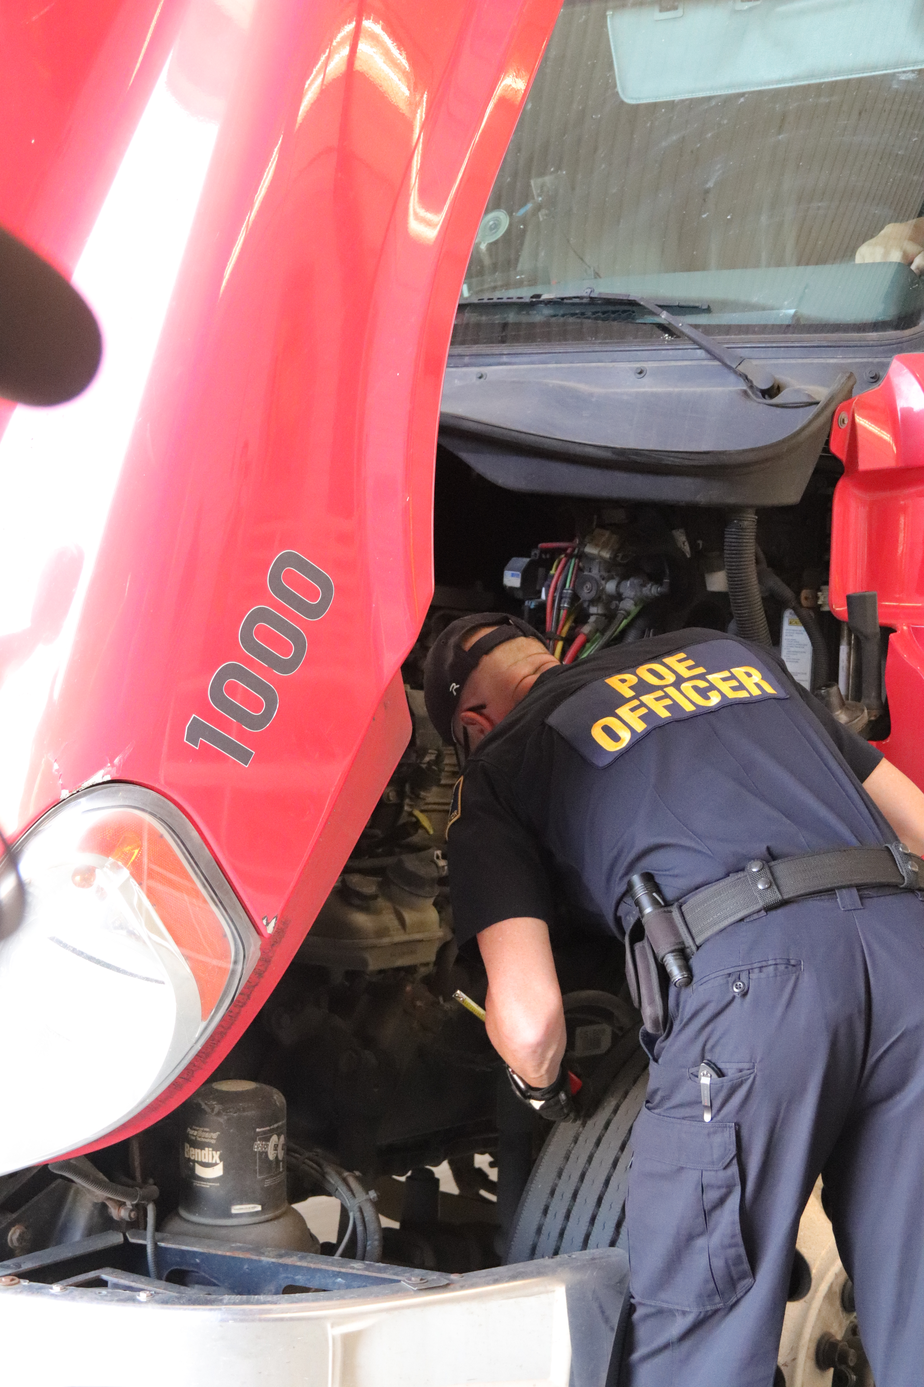
Motor Carrier Regulation and Enforcement
Improve Safety for Motoring Public
Unified & Consistent Enforcement for Industry
Efficient Enforcement Program for the State

Slide 2
1. Make all state officers charged with stopping CMVs public safety specialists

Slide 3
DPS Law Enforcement Authority
The Commissioner of Public Safety and each officer of the Department of Public Safety, as designated and commissioned by the Commissioner, are hereby declared to be peace officers of the State of Oklahoma and shall be so deemed and taken in all courts having jurisdiction of offenses against the laws of the state. Such officers shall have the powers and authority now and hereafter vested by law in other peace officers, including the right and power of search and seizure, except the serving or execution of civil process, and the right and power to investigate and prevent crime and to enforce the criminal laws of this state.
47 O.S. § 2-117(A)

Slide 4
Federal & Tribal Law Enforcement Authority
Troopers & Port of Entry Officers also commissioned to enforce:
Federal Law through Bureau of Indian Affairs Commission
Cherokee Nation Law through Tribal Commission
Chickasaw Nation Law through Tribal Commission
Choctaw Nation Law through Tribal Commission
Muscogee (Creek) Nation Law through Tribal Commission
Quapaw Nation Law through Tribal Commission
Seminole Nation Law through Tribal Commission

Slide 5
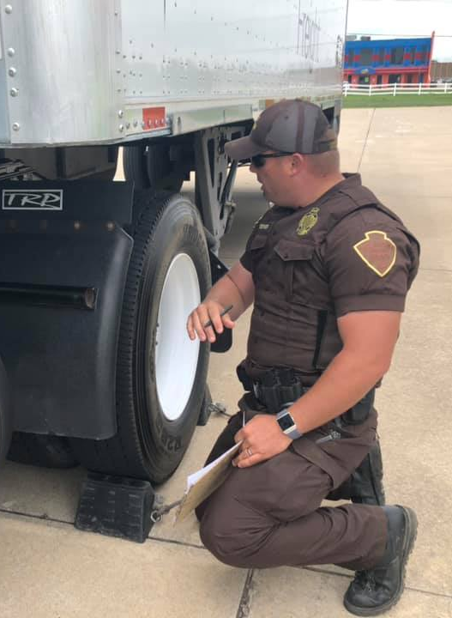
Legislative Public policy:
Motor Carrier Safety & Hazardous Materials Transportation Act
It is therefore declared to be the policy of the State of Oklahoma to provide regulatory and enforcement authority to the Oklahoma Department of Public Safety to improve safety related aspects of motor carrier transportation and to protect the people against the risk to life and property inherent in the transportation of property, including hazardous materials, over highways ...
47 O.S. § 230.2

Slide 6
DPS Authority Under Oklahoma Motor Carrier Safety & Hazardous Materials Transportation Act
[Commissioner] may authorize any officer, employee or agent of the Department to: . . . .
c. stop and inspect any driver or commercial motor vehicle for any violation of the Oklahoma Motor Carrier Safety and Hazardous Materials Transportation Act or rules and regulations issued pursuant thereto,
d. declare and mark any transport vehicle or container as out of service if its condition, filling, equipment or protective devices would be hazardous to life or property during transportation, or if records thereof reflect such hazard …
e. prohibit any commercial driver from transporting hazardous materials if such driver is unqualified or disqualified …, and
f. administer and enforce the provisions of the Oklahoma Motor Carrier Safety and Hazardous Materials Transportation Act and any rules and regulations issued pursuant thereto.
47 O.S. § 230.4

Slide 7
Certifications for NAS Inspections
FMCSA North American Standard – A School
Certification to Perform Inspections of Drivers for Compliance with Federal Motor Carrier Safety Regulations
40 Hour Course
32 Apprentice Inspections
32 (Minimum) Inspections Annually to Maintain
FMCSA North American Standard – B School
Certification to Perform Inspections of Commercial Motor Vehicles for Compliance with Federal Motor Carrier Safety Regulations
40 Hour Course
32 Apprentice Inspections
32 (Minimum) Inspections Annually to Maintain
FMCSA Hazardous Materials – General HazMat School
Certification to Perform Inspections for Compliance with Federal Hazardous Materials Regulations
40 Hour Course
8 Apprentice Inspections
8 (Minimum) Inspections Annually to Maintain
FMCSA Hazardous Materials – HazMat Cargo Tank School
Certification to Perform Inspections for Compliance with Federal Hazardous Materials Regulations for Cargo Tanks
40 Hour Course
8 Apprentice Inspections
8 (Minimum) Inspections Annually to Maintain

Slide 8
North American Standard Inspections
Level I is a 37-step inspection procedure that involves examination of the motor carrier’s and driver’s credentials, record of duty status, the mechanical condition of the vehicle and any hazardous materials/dangerous goods that may be present.
Level II is a driver and walk-around vehicle inspection, involving the inspection of items that can be checked without physically getting under the vehicle.
Level III is a driver-only inspection that includes examination of the driver’s credentials and documents.

Slide 9
NAS Inspections - Continued
Level IV special inspections are a one-time examination of a particular item. These examinations are normally made in support of a study or to verify or refute a suspected trend.
Level V is a vehicle-only inspection which may be performed without a driver present, at any location.
Level VI is a specialized inspection of transuranic waste and highway route controlled quantities of radioactive material.
Level VII is a jurisdictionally mandated inspection.
Level VIII is an inspection conducted electronically or wirelessly while the vehicle is in motion, without direct interaction with an inspector.

Slide 10
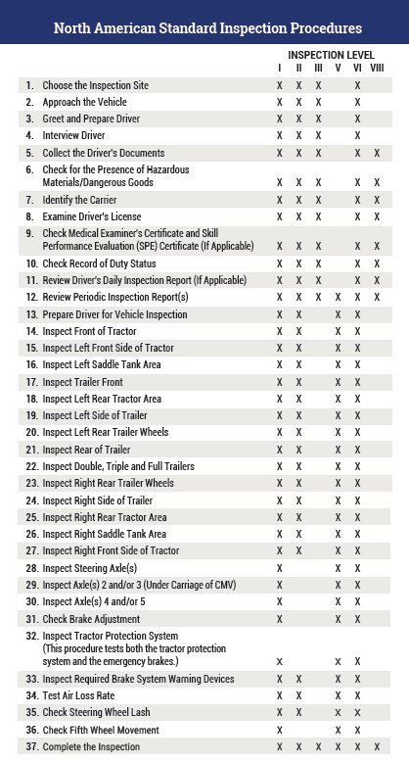
Inspection Steps Handout

Slide 11
Out of Service Manual
CVSA’s North American Standard Out-of-Service Criteria ensure uniformity, consistency and reciprocity among the states, provinces, territories and countries and determine whether or not drivers or vehicles present an imminent hazard and should be placed out of service. The federal regulations, together with CVSA’s out-of-service criteria, provide the standards that drivers, motor carriers and law enforcement personnel use to ensure the commercial motor vehicles and drivers operating on North America’s roadways are safe and compliant.

Slide 12
DPS Port of Entry Officers (2022)
Total Inspections: 10,179
Total Safety Violations: 26,056
Total Out of Service: 4,296
Vehicle: 3,342
Driver: 1,653

Slide 13
Troopers (2022)
Total Inspections: 28,794
Total Safety Violations: 53,811
Total Out of Service: 5,349
Vehicle: 4,416
Driver: 1,482
Motor Carrier Outreach
Education Outreach: 132

Slide 14
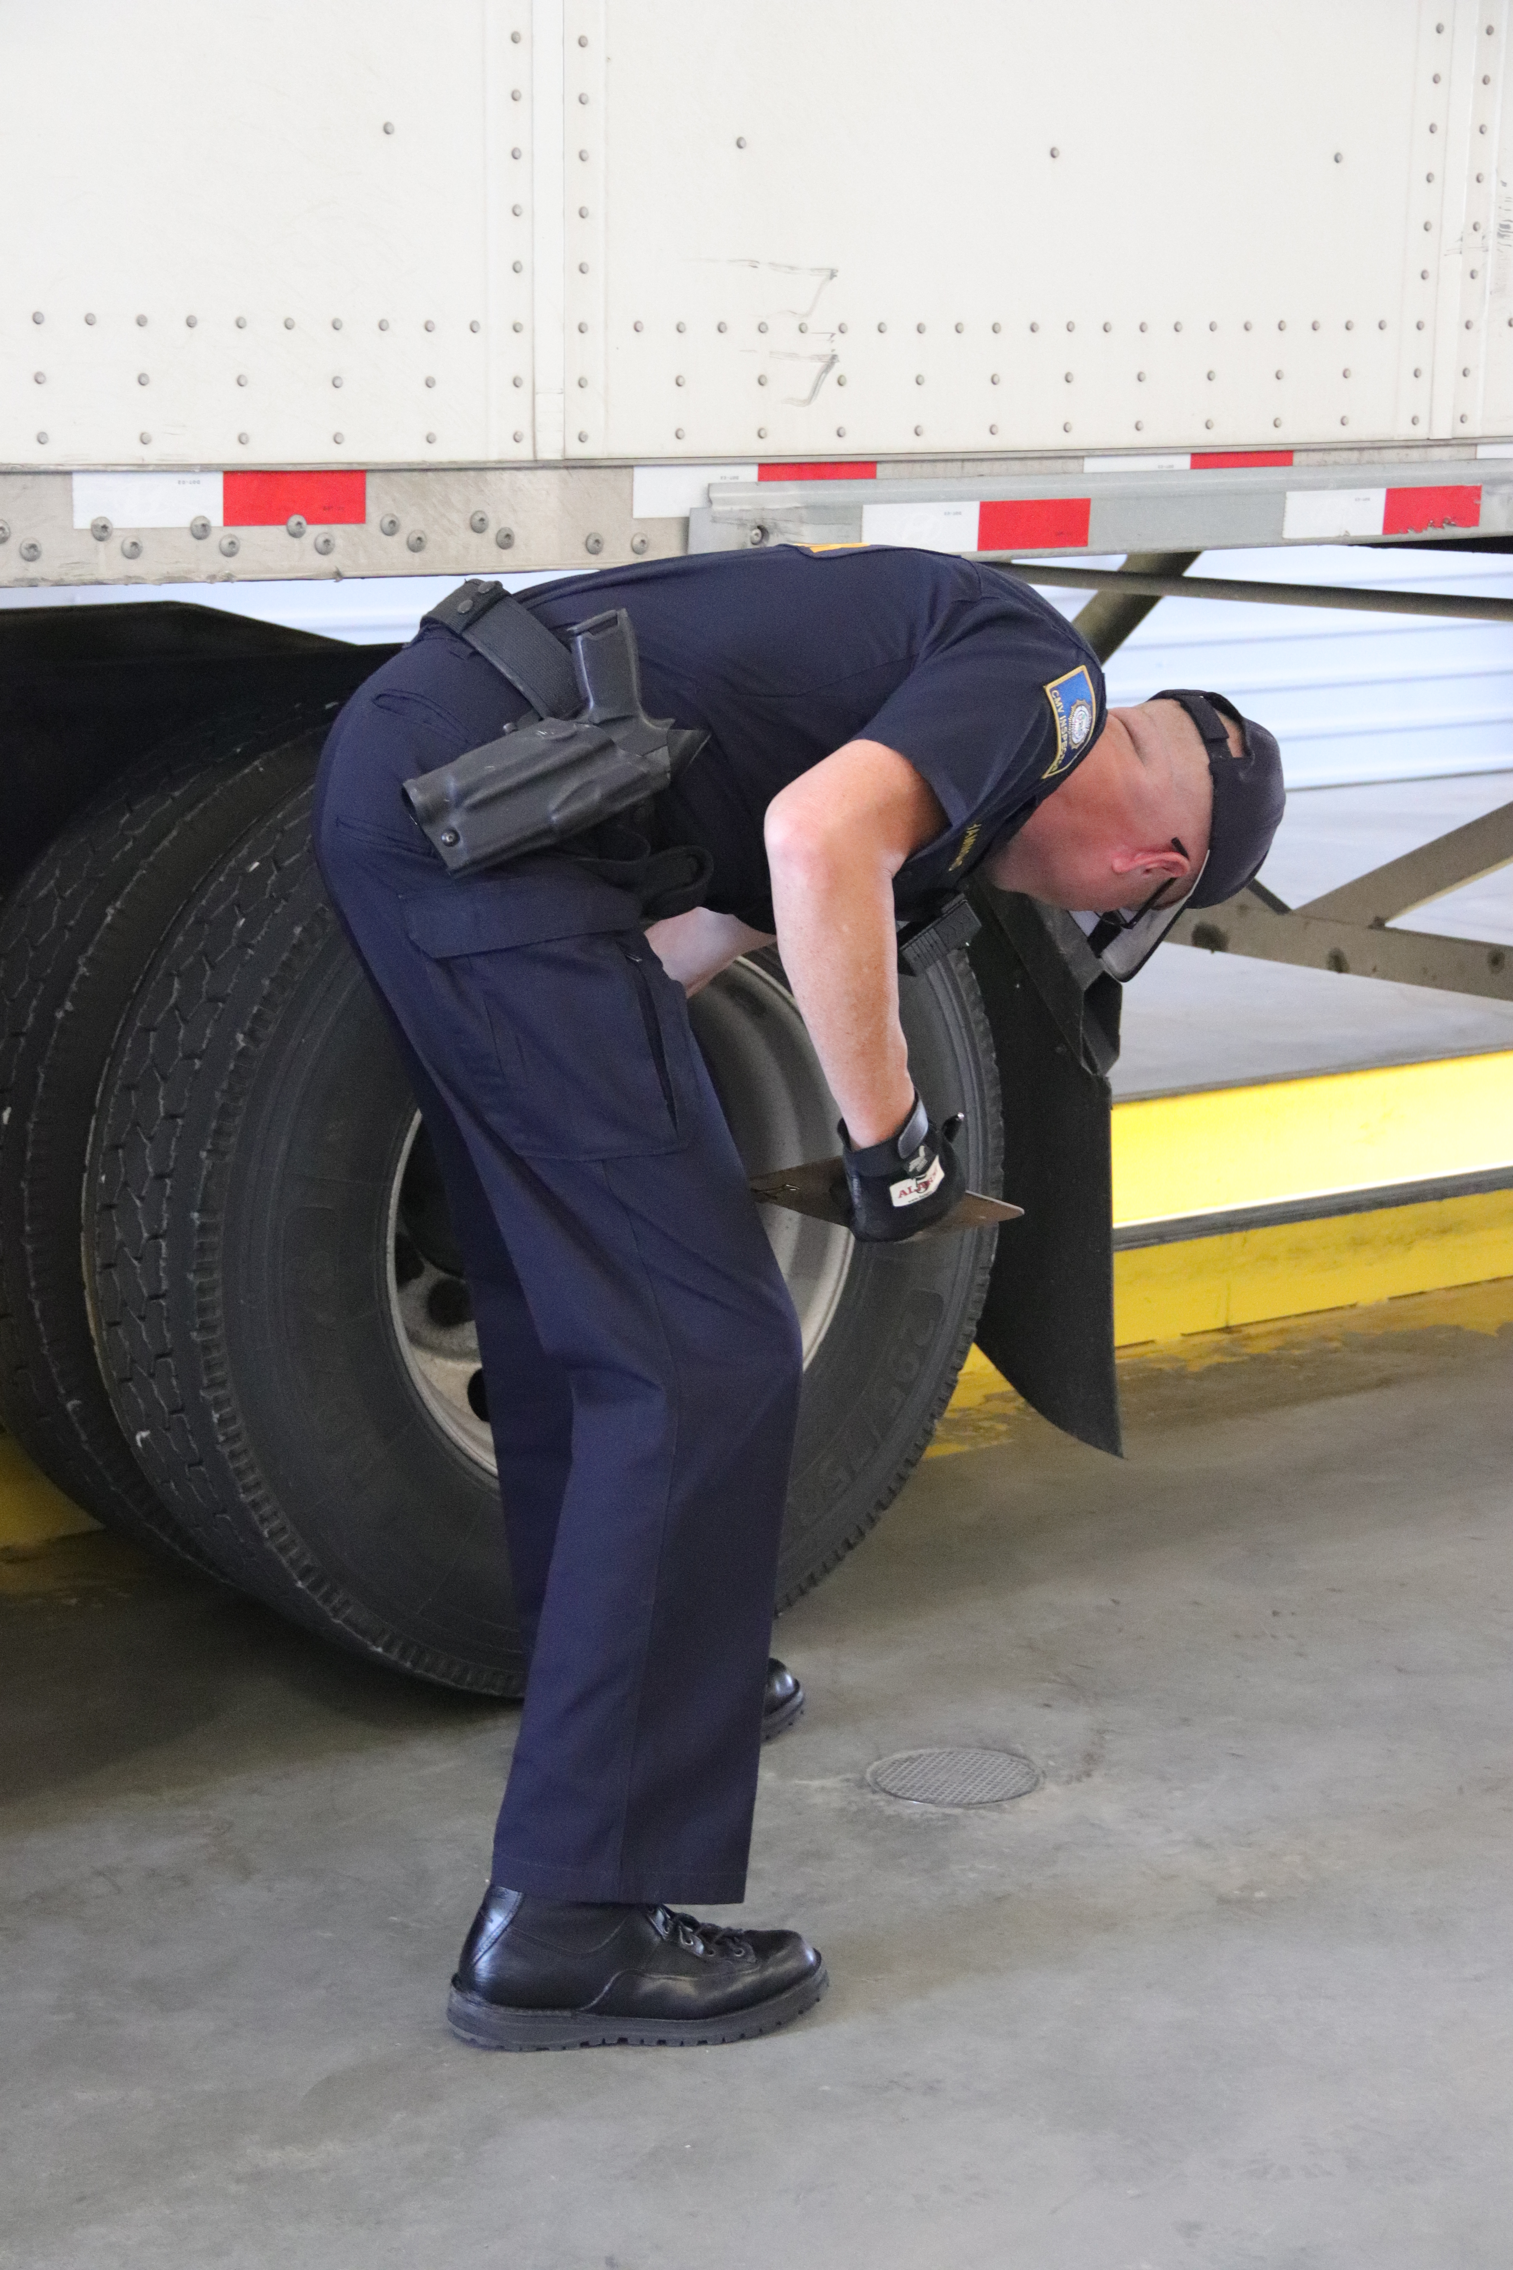
if All State cmv officers were UNDER DPS Umbrella
Nearly double the number of officers trained, certified and authorized to perform full safety inspections
Ensure all commissioned officers staffing ports of entry and fixed weigh station are authorized to perform safety inspections
Empower all state officers charged with stopping CMVs to enforce all of Title 47 Rules of the Road & other criminal laws
All interior fixed weigh stations could become CMV inspection stations – not just the Ports of Entry

Slide 15
Examples of Public Safety Gaps
DPS
DUI – Jail / Impound Vehicle
Criminal Interdictions – Jail / Seizure
No Brake Lights – Out of Service Until Corrected
Suspended DL – Jail / Impound Vehicle
Federal Out of Service – Placed OOS Until Corrected
Eluding – Pursued by DPS
OCC
DUI – Call DPS
Criminal Interdictions – Call DPS
No Brake Lights – Call DPS
Suspended DL – Call DPS or Let Them Go
Federal Out of Service – Call DPS or Fine and Release
Eluding – Call DPS After 25 Mile Radius

Slide 16
2. Develop Unified & Consistent Approach to CMV Enforcement

Slide 17
Confusing for the Industry
Citations from Two Agencies During Single Encounter
Motor carriers and drivers experience frustration when they receive enforcement action from two different agencies during a single trip through a port of entry. Though the fines may be for different types of violations, experiencing enforcement from two agencies during a single encounter fosters a perception of unfairness.
Certain Violations Risk Duplicate Fines
Though rare, it is possible for carriers to experience duplicate enforcement actions for the same type of violation. For example, OCC enforces overweight violations through a civil fine structure. DPS enforces overweight violations through the statutory criminal fine structure. Compare 47 O.S. § 170.2 with §§ 14-109, 14-119.
Permitted Oversize/Overweight Loads
Oversize/overweight loads are often required to remain on pre-approved routes. Troop S receives calls from such motor carriers who are commanded by OCC officers to depart from permitted routes to travel to OCC weigh stations.

Slide 18
3. Reduce Costs and Enhance Efficiency

Slide 19
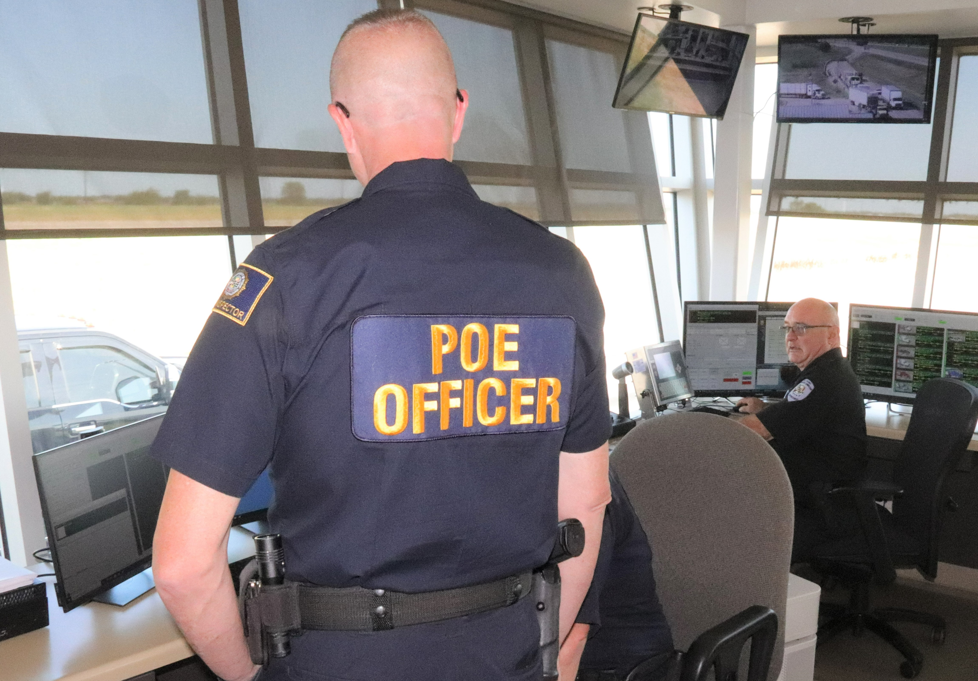
Officers of two agencies staffing the same facility

Slide 20
Ports of Entry
DPS Officers
Oklahoma Motor Carrier Safety and Hazardous Materials Transportation Act
Motor Carrier Safety Regulations & Hazmat Regulations
Commercial Vehicle Safety Alliance Out of Service Criteria
Title 47 Rules of the Road
Impaired Driving
Driving Under Suspension
Driving in Violation of Out of Service Order
All other state, federal, and tribal criminal laws
OCC Officers
Household Goods Certification
Hazardous Waste Permitting
Unified Carrier Registration
Financial Responsibility
Deleterious Substances Permits
Harvest Permits
Unladen/Hunters Permits
International Registration Plan
International Fuel Tax Agreement

Slide 21
Interior Weigh Stations
X
DPS Officers
Oklahoma Motor Carrier Safety and Hazardous Materials Transportation Act
Motor Carrier Safety Regulations & Hazmat Regulations
Commercial Vehicle Safety Alliance Out of Service Criteria
Title 47 Rules of the Road
Impaired Driving
Driving Under Suspension
Driving in Violation of Out of Service Order
All other state, federal, and tribal criminal laws
OCC Officers
Household Goods Certification
Hazardous Waste Permitting
Unified Carrier Registration
Financial Responsibility
Deleterious Substances Permits
Harvest Permits
Unladen/Hunters Permits
International Registration Plan
International Fuel Tax Agreement

Slide 22
Combining All State CMV Enforcement Officers Under DPS
Every officer empowered to enforce ALL the laws
Every officer’s focus on public safety laws (without neglecting regulatory laws)
Ports of Entry can be operated with fewer officers per shift, freeing up officers to hold Ports open more hours per week and to increase the operations at interior weigh stations
Interior weigh stations become stations for safety inspections
Even with the same total number of officers, there will be opportunities to reduce total program costs
Motor carriers and drivers experience a unified and consistent approach to law enforcement
Enhance DPS’s capacity to operate virtual weigh stations

Slide 23
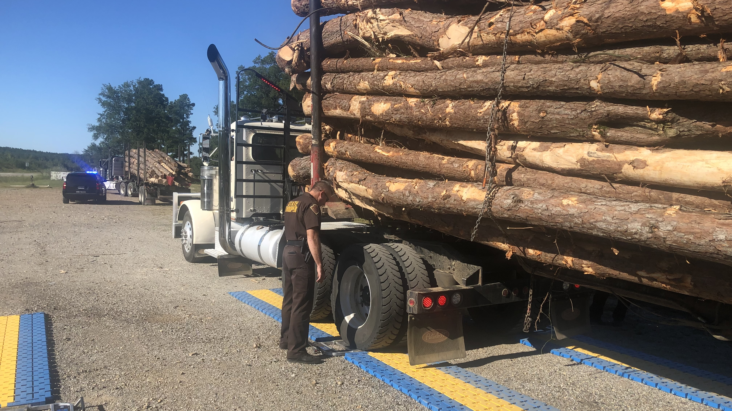
Virtual Weigh Stations

Slide 24
Transition Goals
DPS to receive all OCC enforcement staff who wish to make transition
Incoming staff will suffer NO pay reduction
Cross train all commissioned and civilian officers to provide uniform approach to enforcement
Eliminate duplicate fines/penalties
Capitalize on cost efficiencies

Slide 25
Year One
Transfer/on-board applicable OCC staff to DPS
Commissioned & civilian enforcement officers
Applicable administrative/support personnel
Job duties & assignments initially stay the same for continuity of operations
Incoming OCC officers will attend 3-week POE bridge academy (through OHP), such training organized to preserve continuity of operations
DPS will begin a phased program to train all incoming officers to perform North American Standard safety inspections
Non-commissioned OCC officers will be evaluated for invitation to attend a peace officer academy

Slide 26
Year Two
Incoming OCC Officers will continue N.A.S. training for:
General Hazardous Material
Cargo Tank
Bulk Package
All applicable civil and criminal fines will be evaluated for fairness, appropriate public safety and deterrent effect, and avoidance of duplication or over-enforcement
DPS will continue to seek opportunities for total program cost efficiencies

Slide 27
Current Funding for DPS Port of Entry Staffing
$2.5M
Statutorily allocated from size and weight permits “for the purpose of staffing the port of entry weigh stations with Department of Public Safety port of entry officers”
47 O.S. § 14-116(H)
$300K
Statutorily allocated from fines and penalties collected or received by the Corporation Commission pursuant to the provisions of the Trucking One-Stop Shop Act
47 O.S. § 1167(C)

Slide 28
Funding for OHP / Troop S Personnel
Not Applicable to Port of Entry Staffing

Slide 29
OHP / TROOP S Federal MCSAP Funding
FFY2023 Federal MCSAP Funding: $8,539,468
Position Federal Funding Level
Major 80%
Captain 95%
Lieutenant 90%
Troopers 70%
New Entrant Auditors 100%
Administrative Support 100%

Slide 30
TROOP S: Civil Penalties
The first One Hundred Thousand Dollars ($100,000.00) of the administrative penalties collected each fiscal year pursuant to the provisions of the Oklahoma Motor Carrier Safety and Hazardous Materials Transportation Act shall be deposited in the General Revenue Fund of the State of Oklahoma. All other monies collected in excess of One Hundred Thousand Dollars ($100,000.00) each fiscal year shall be deposited to the credit of the Department of Public Safety Restricted Revolving Fund for the purpose of administering the Oklahoma Motor Carrier Safety and Hazardous Materials Transportation Act. 47 O.S. § 230.9(H)
SFY22 Civil Penalties: $2,723,179.96

Slide 31
Code of Ethics: “As a law enforcement officer, my fundamental duty is to serve the community; to safeguard lives and property….”
Improve Safety for Motoring Public
Unified & Consistent Enforcement for Industry
Efficient Enforcement Program for the State

