Slide 1
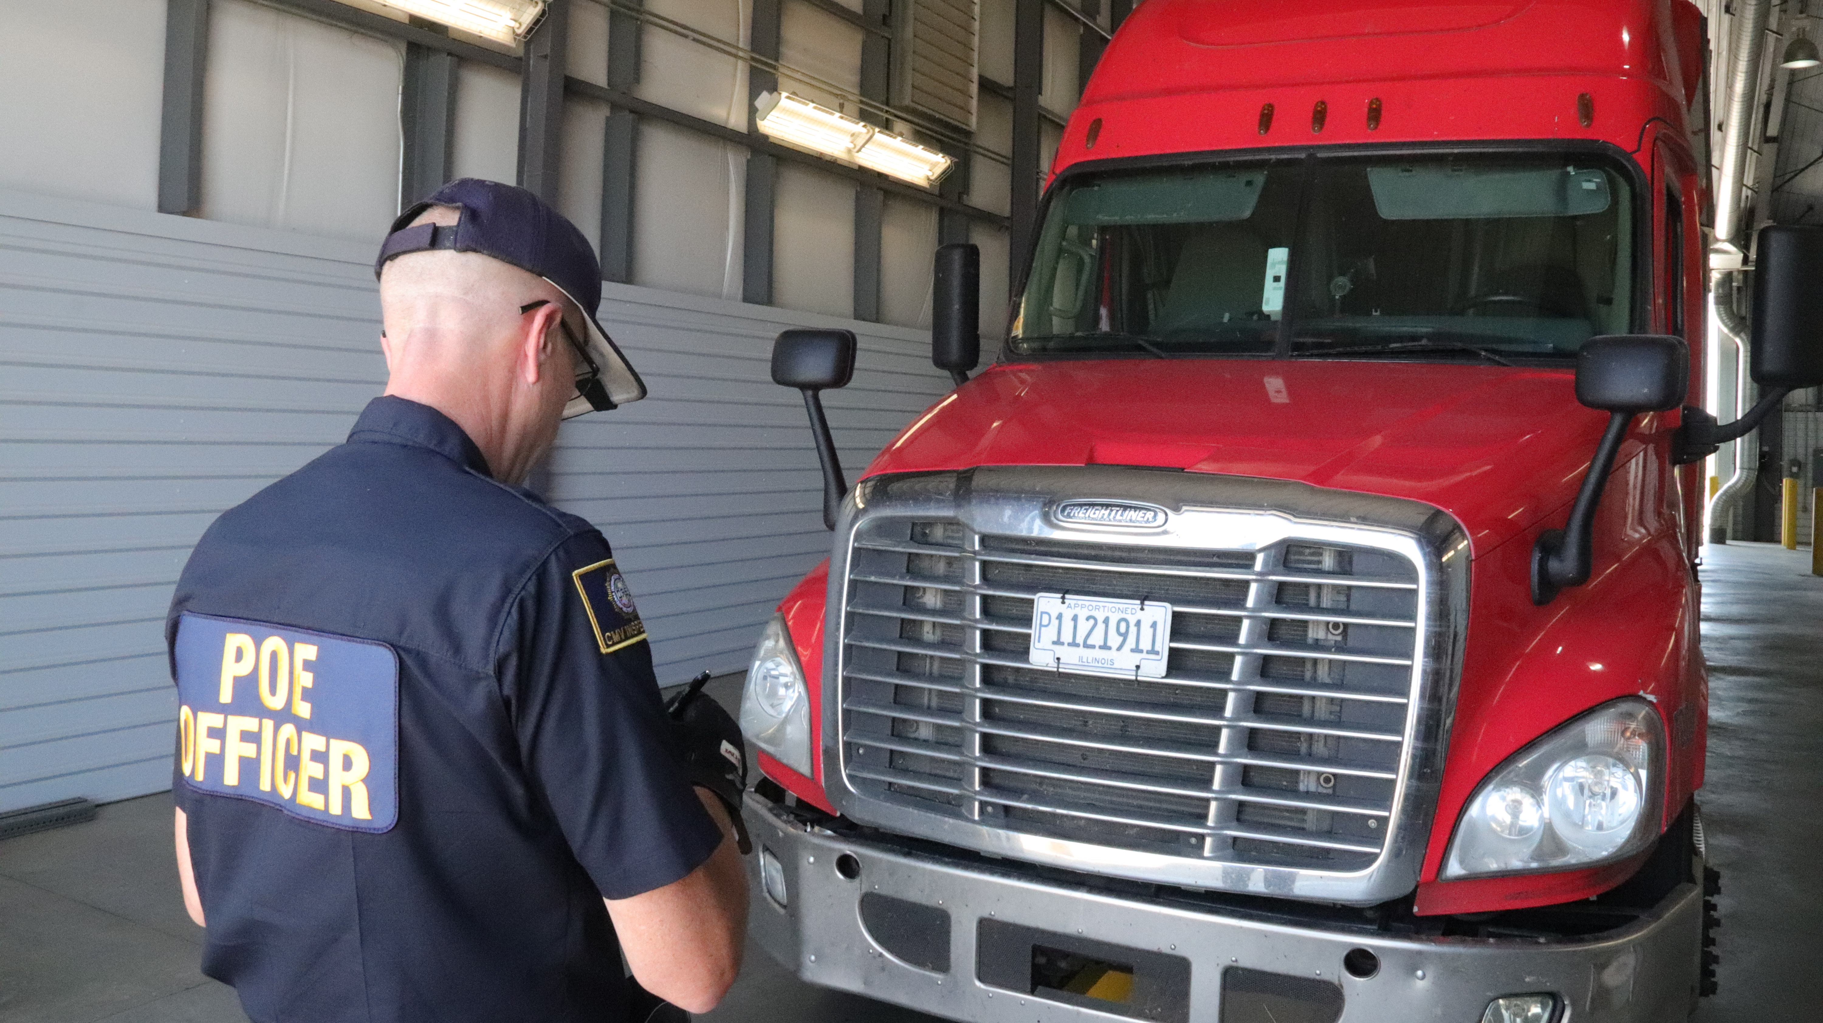
DPS Staffing

Slide 2
Current Troop S Org Chart
Chief of Patrol
Col. Patrick Mays
Zone Commander
Maj. Garrett Vowell
Troop S
Cpt. Brian Orr
Northwest
Lt. Deming
Northeast
Lt. Eberle
Southwest
Lt. Whittington
Southeast
Lt. Allen
NE / SA
Lt. Weedon
Central
Lt. Hellums
CVSA
Lt. Jenkins
POE
Lt. Logan
Port of Entry Program
Love & Beckham
Sgt. Ressler
Sequoyah
Sgt. Rowley
Officers
Kay
Open
Officers
Officers
Troopers
Troopers
Troopers
Troopers
Troopers
Troopers
Troopers

Slide 3
Troop S Reorganization
Zone Commander
Maj. Garrett Vowell
EXISTING OHP PERSONNEL
Commander Over DPS Officers
Cpt.
OHP Troop Commander
Cpt. Brian Orr
NW Region
Lt.
SE Region
Lt.
XO Over Program Administration
Cpt.
CVSA
Lt. Jenkins
Program Administrator
Administrative Staff
Boise City
Sgt.
El Reno
Sgt.
KPOE
Sgt.
BPOE
Sgt.
SPOE
Sgt.
LPOE
Sgt.
BRYPOE
Sgt.
Hugo
Sgt.
Davis
Sgt.
Officers
Officers
Officers
Officers
Officers
Officers
Officers
Officers
Officers

Slide 4
Projected Staffing Budget

Slide 5
Projected Staffing Budget
ESTIMATED COSTS FOR TRANSFER AND ONBOARDING ENFORCEMENT STAFF
OBJECT CODE CATEGORY | DESCRIPTION | EXPLANATION | Year 1 | Year 2 | Year 3, 4, 5…
SALARY & FRINGE
511 | SALARY** | 166 FTE (based on Workday Data) | $9,790,801.93 | $9,790,801.93 | $9,790,801.93
512-519 | FRINGE BENEFITS** | 166 FTE (based on Workday Data) | $6,304,422.00 | $6,304,422.00 | $6,304,422.00
SUBTOTAL (Not Including Indirect Costs) |  |  | $16,095,223.93 | $16,095,223.93 | $16,095,223.93
OPERATING COSTS (Based on 129 Currently Filled Positions)
521 | TRAVEL REIMBURSED** | 3wk POE Academy | $123,840.00 | $0.00 | $9,600.00
 |  | 2wk North American A&B | $82,559.22 | $0.00 | $6,399.94
 |  | 1wk General HM | $0.00 | $41,280.78 | $3,200.06
 |  | 1wk Bulk/Cargo Tank | $0.00 | $41,280.78 | $3,200.06
 |  | Other S&W/FMCSA Training | $45,150.78 | $3,500.00 | $3,500.06
522 | TRAVEL DIRECT EXPENDITURE** | 3wk POE Academy - RTI | $74,304.00 | $0.00 | $5,760.00
 |  | 2wk North American A&B - RTI | $49,536.00 | $0.00 | $3,840.00
 |  | 1wk General HM - RTI | $0.00 | $24,768.00 | $1,920.00
 |  | 1wk Bulk/Cargo Tank | $0.00 | $24,768.00 | $1,920.00
 |  | Other S&W/FMCSA Training | $32,249.22 | $2,499.94 | $2,499.94
531 | MISCELLANEOUS ADMINISTRATIVE EXPENSE | Cell Phone w/SIM card | $203,175.00 | $203,175.00 | $203,175.00
 |  | Inspection decals, regulation books, OOS Criteria, etc | $58,695.78 | $58,695.78 | $58,695.78
533 | MAINTENANCE & REPAIR EXPENSE | Vehicle repair & maintenance (Comdata) | $255,790.68 | $255,790.68 | $255,790.68
534 | SUPPLIES AND MATERIAL EXPENSE | Fuel (Comdata) | $866,106.00 | $866,106.00 | $866,106.00
535 | PRODUCTION EXPENSE, SAFETY & SECURITY EXPENSE | Uniforms, bump caps, safety goggles, etc. | $193,500.00 | $193,500.00 | $193,500.00
536 | OFFICE EXPENSE | Office supplies | $58,050.00 | $58,050.00 | $58,050.00
537 | SHOP EXPENSE | Vehicle supplies, parts, accessories | $32,249.22 | $32,249.22 | $32,249.22
541 | OFFICE FURNITURE & EQUIPMENT | Laptops | $193,500.00 | $193,500.00 | $193,500.00
 |  | Portable scales & racks | $290,250.00 | $290,250.00 | $290,250.00
542 | EQUIPMENT - LIBRARY | Training textbooks | $12,356.02 | $12,356.02 | $12,356.02
SUBTOTAL |  |  | $2,571,311.93 | $2,301,770.20 | $2,205,512.77
 |  | Per Person / Per Year | $19,932.65 | $17,943.18 | $17,097

Slide 6
Transition Plan

Slide 7
Transition Goals
DPS to receive all OCC enforcement staff who wish to make transition
(Anticipated Need for Narrow OLERS Exception)
Incoming staff will suffer NO pay reduction
Cross train all commissioned and civilian officers to provide uniform approach to enforcement
Capitalize on cost efficiencies

Slide 8
Year One
Transfer/on-board applicable OCC staff to DPS
· Commissioned & civilian enforcement officers
· Applicable administrative/support personnel
Job duties & assignments initially stay the same for continuity of operations
Incoming OCC officers will attend 3-week POE bridge academy (through OHP), such training organized to preserve continuity of operations
Non-commissioned OCC officers will be evaluated for invitation to attend a peace officer academy
DPS will begin a phased program to train all incoming officers to perform North American Standard safety inspections

Slide 9
Year Two
Incoming OCC Officers will continue N.A.S. training for:
· General Hazardous Material
· Cargo Tank
· Bulk Package
DPS will continue to seek opportunities for total program cost efficiencies

Slide 10
