Slide 1
Oklahoma Corporation Commission Transportation Division Overview
September 20, 2023

Slide 2
The Oklahoma Corporation Commission General Information
Established by the Oklahoma Constitution in 1907 with state-wide elected officials.
Full-time employees agency wide: 519 actual, 589 budgeted
Composed of distinct subject matter Divisions that share support resources and a constitutionally-established court of record.*
Commission Divisions:
Public Utility Division
Oil and Gas Division
Petroleum Storage Tank Division
Transportation Division
Administrative, Judicial and Legal Services Division (Agency administration, HR, Finance, IT, General Counsel, Court System, Public Information Office, etc.)
The OCC court system is unique in state government in that it is an administrative court of record that appeals directly to the Oklahoma Supreme Court.*
* Oklahoma Constitution, Article IX, Sections 19-20.

Slide 3
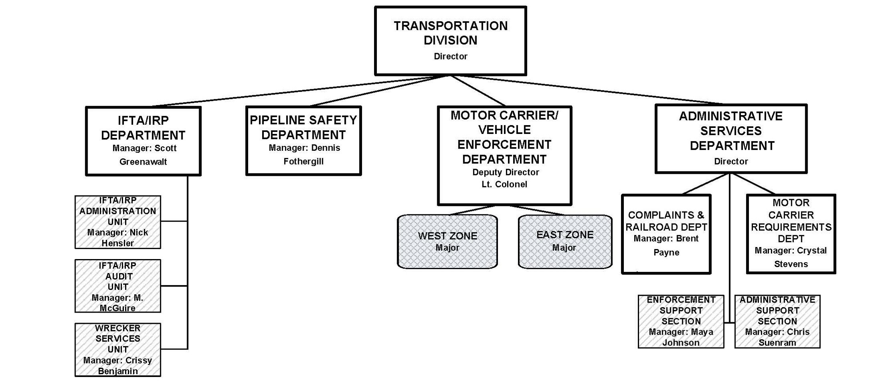
Transportation High-Level Division Structure

Slide 4
Transportation Division Full Time Employees
as of September 20, 2023
Actual: Total with vacancies:
Field Enforcement: 131 165
Enforcement Support: 8 9
IFTA/IRP: 28 30
Wrecker: 3 3
Railroad: 1 1
Administration: 8 8
Requirements: 5 5
Pipeline Safety: 22 27
Total: 206 248

Slide 5
Transportation Motor Carrier Field Enforcement
Oklahoma Corporation Commission | Transportation Division

Slide 6
Enforcement Organizational Chart

Slide 7
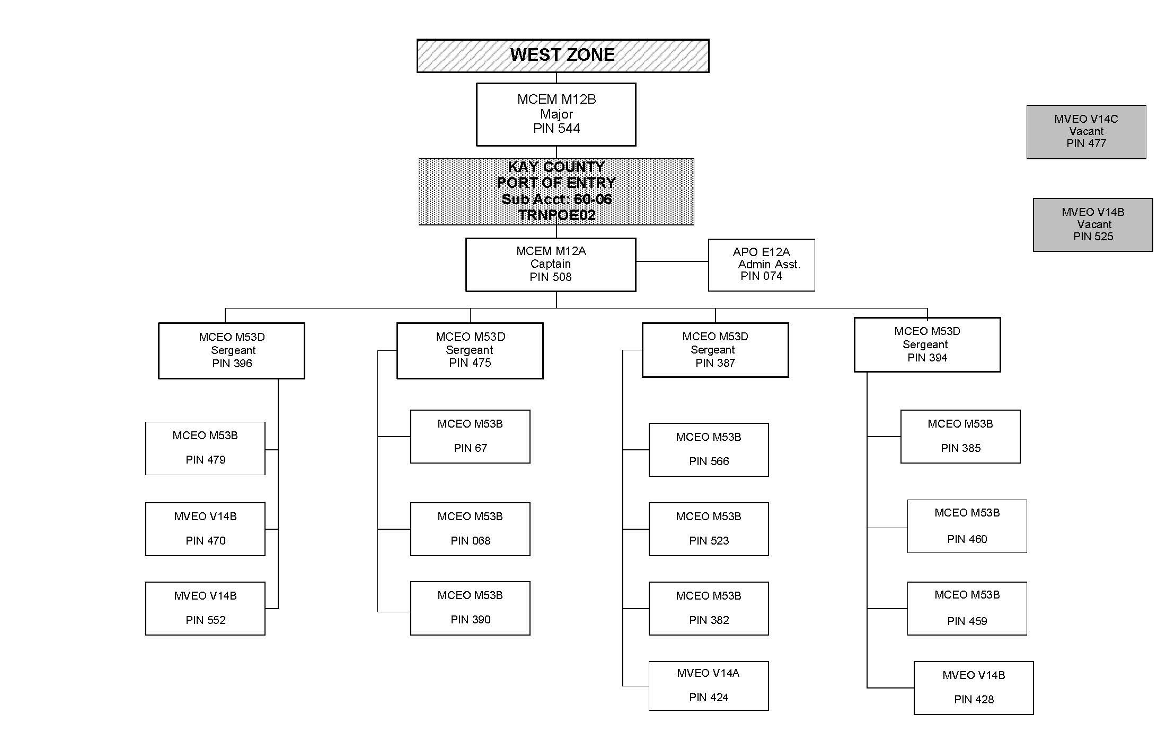
Example POE Organizational Chart

Slide 8
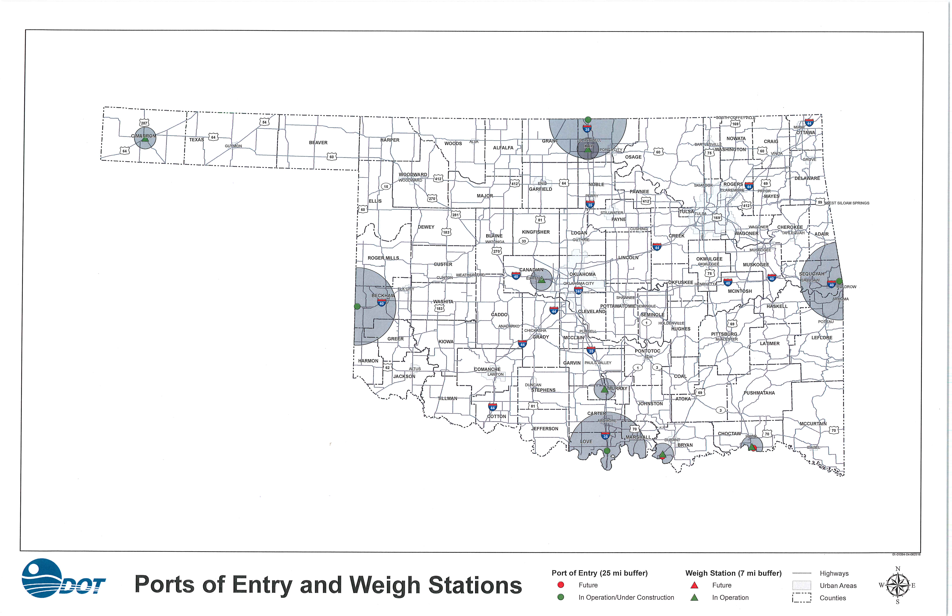
Current Ports of Entry and Weigh Stations

Slide 9
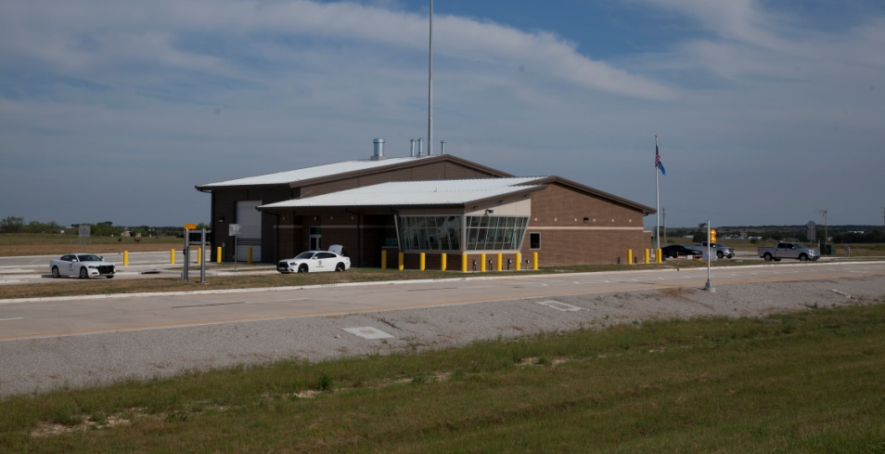
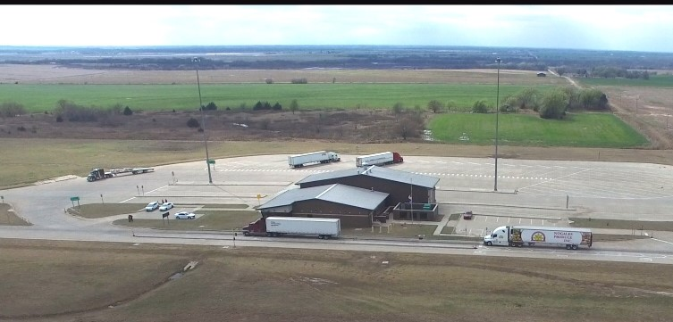
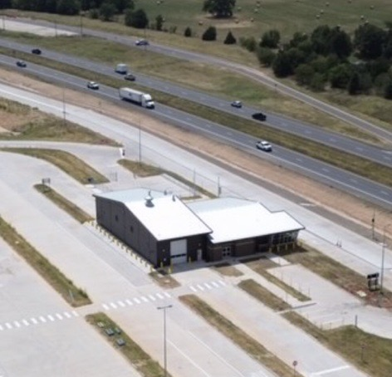
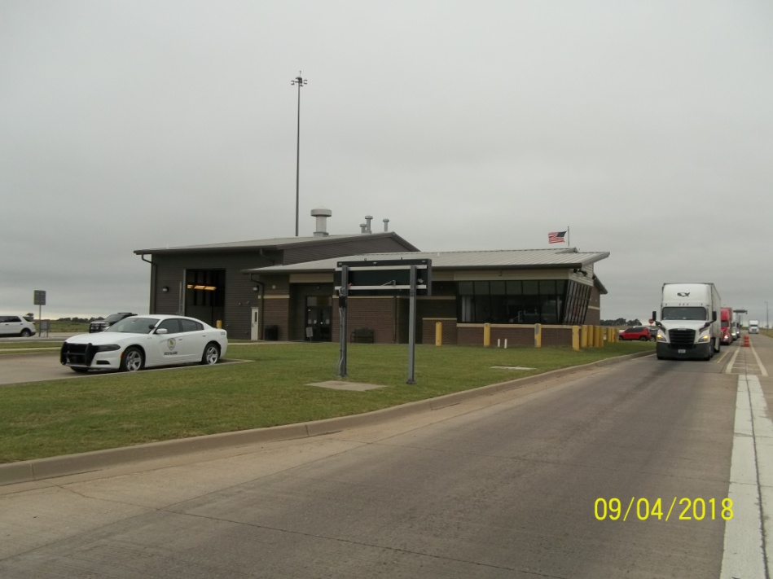
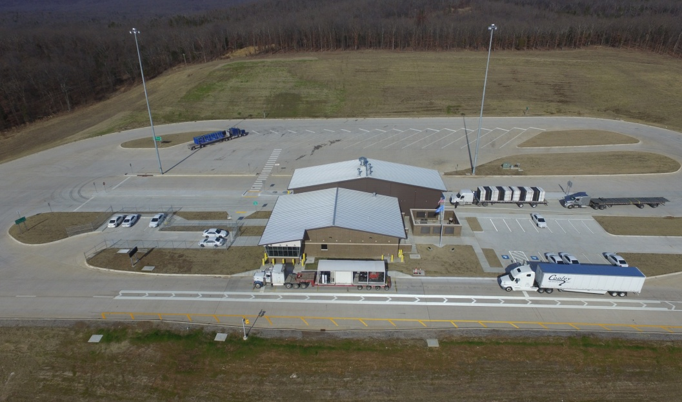
Oklahoma's Ports of Entry
LPOE (Love County)
KPOE (Kay County)
BryPOE (Bryan County)*
BPOE (Beckham County)
SPOE (Sequoyah County)
*Under Construction

Slide 10
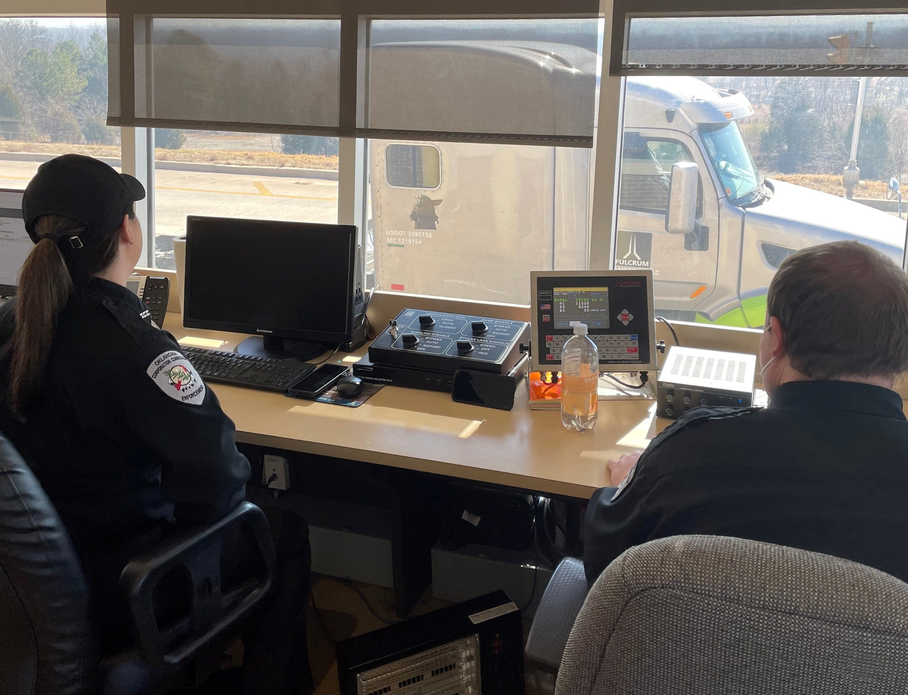
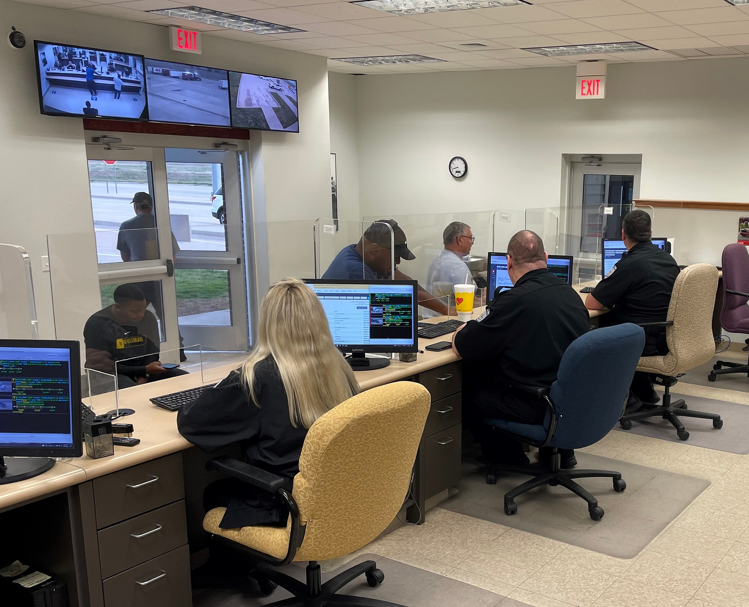
Ports of Entry (POE)
OCC operates four ports of entry and a fifth scheduled to be opened in October of 2023.
Two POEs on I-40 and two on I-35 with a fifth port opening on Hwy 69.
Thorough checks are accomplished through interaction with drivers and their paperwork.
Ports are equipped with an electronic screening system that checks compliance with federal and state regulations and allows for a 70%-80% on-highway bypass rate without requiring the motor carrier to adopt third-party technology.
Warnings or citations may be issued for various violations, with size and weight violations enforced via static scales.
Over six million commercial motor vehicles screened yearly.
10

Slide 11
POE Electronic Screening System (ESS)

Slide 12
Zone 2 – Right Lane Bending Plate WIM System

Slide 13
Zone 2 – Right Lane License Plate Reader (LPR) - OCR
Mainline Compliance LPR

Slide 14
Zone 2 – Right Lane USDOT Number Reader - OCR

Slide 15
Zone 2 – Visible Light Beam Overheight Detection

Slide 16
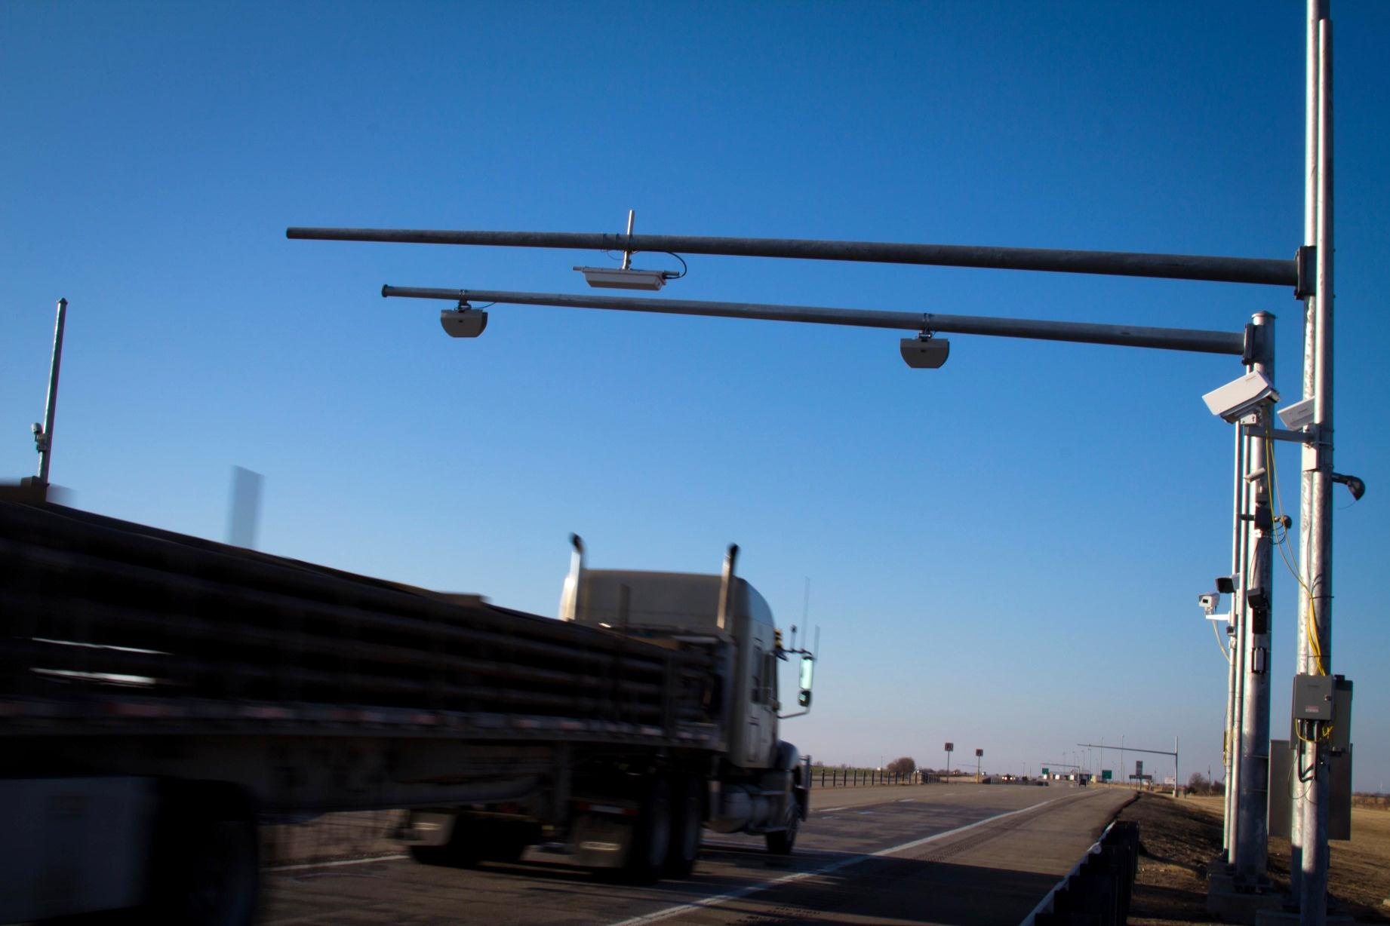
Zone 2 – Laser Scanners Over-width Detection

Slide 17
Zone 3 – Variable Message Sign (VMS) Truck Bypass Weigh Station Message

Slide 18
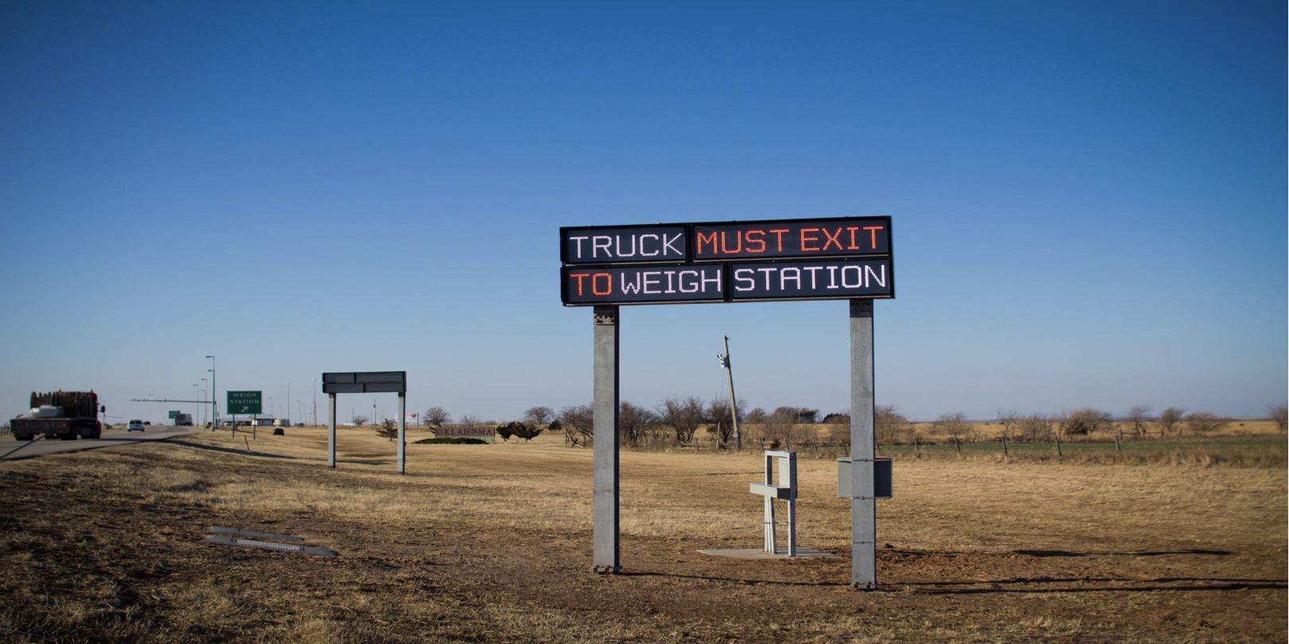
Zone 3 – Variable Message Sign (VMS) Truck Must Exit to Weigh Station Message

Slide 19
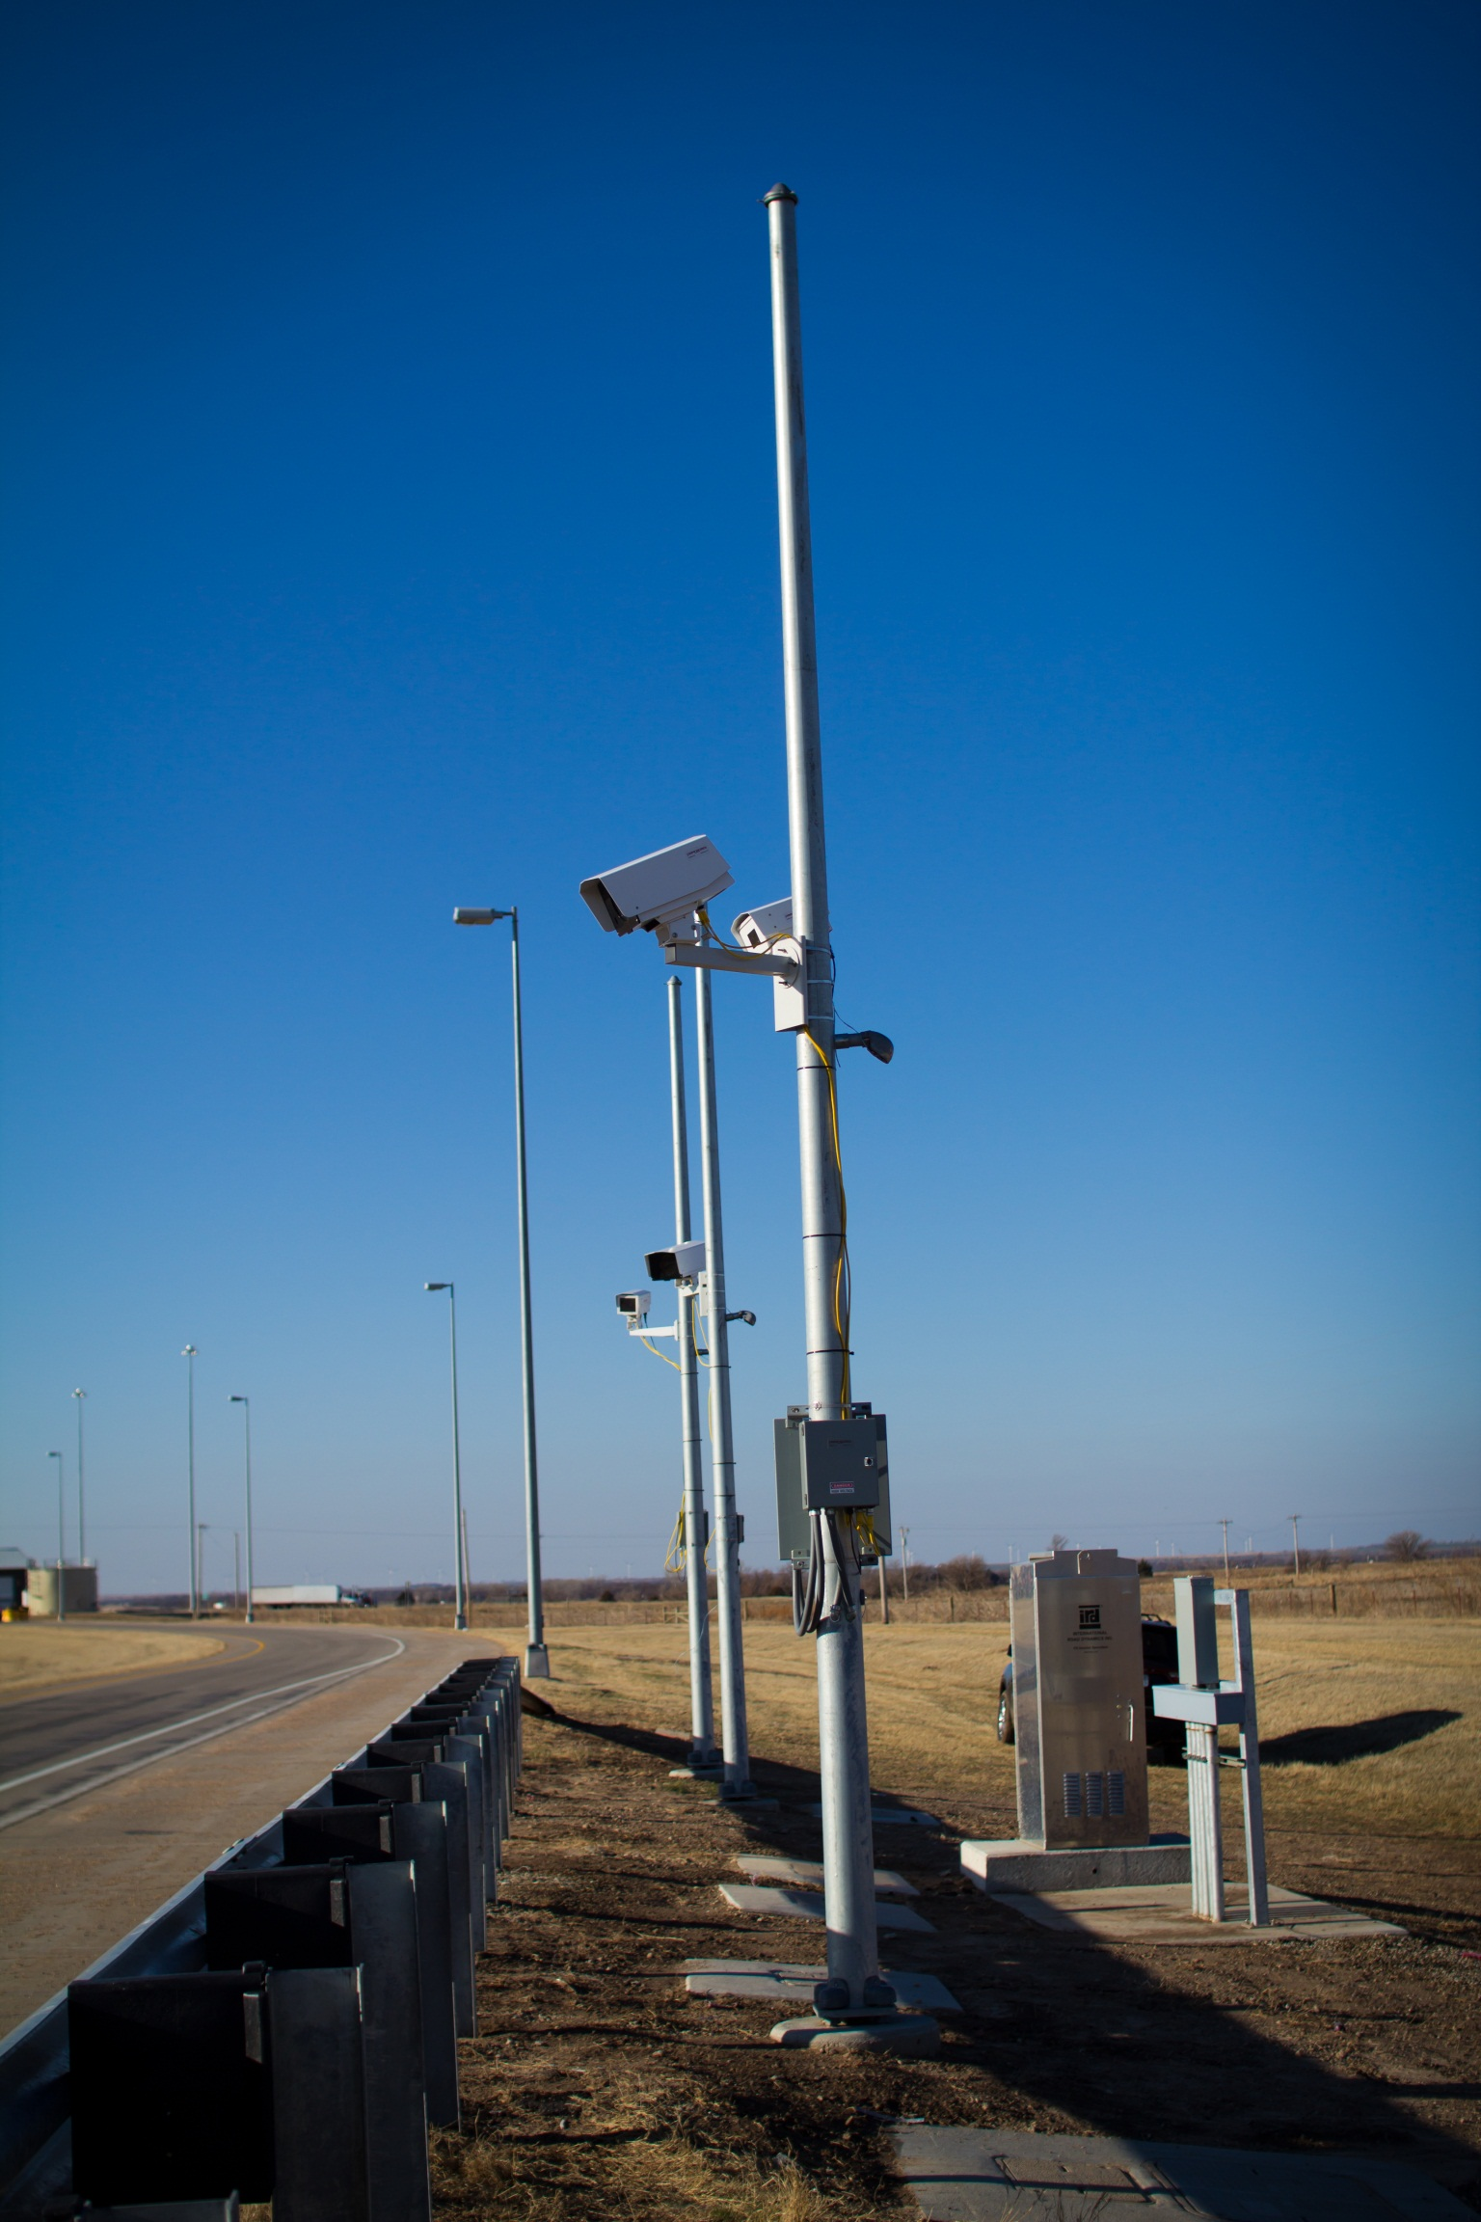
Zone 5 – License Plate Recognition & USDOT Cameras

Slide 20
Zone 6 – Variable Message Sign (VMS) and Digital Traffic Control (DTC)

Slide 21
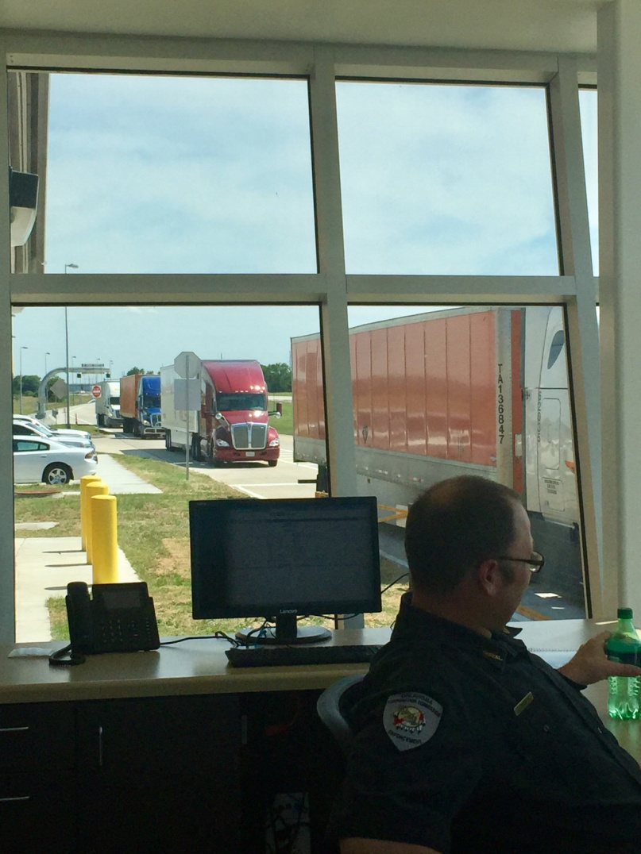
Items Reviewed by the ESS
All forms of motor carrier credentials (IFTA/IRP, USDOT, Permits, Operating Authority, etc.)
Vehicle Size (Height, Width and Depth)
Weight on Gross, Bridge, and Axle
Federal Motor Carrier Safety Administration (FMCSA) Safety Rating
Tire Anomaly and Classification System (TACS)
Thermal Brake Imaging
Ramp Backup Detection

Slide 22
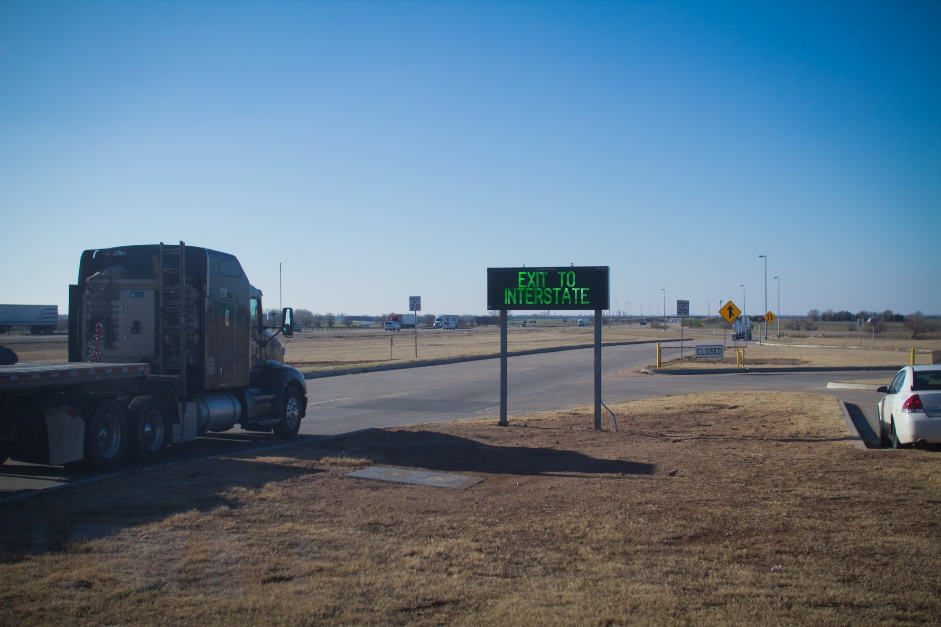
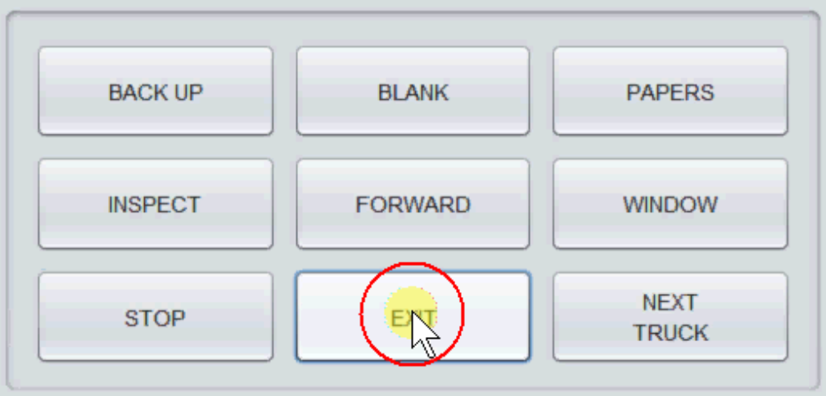
Static Scale Lane Variable Message Sign (VMS)

Slide 23
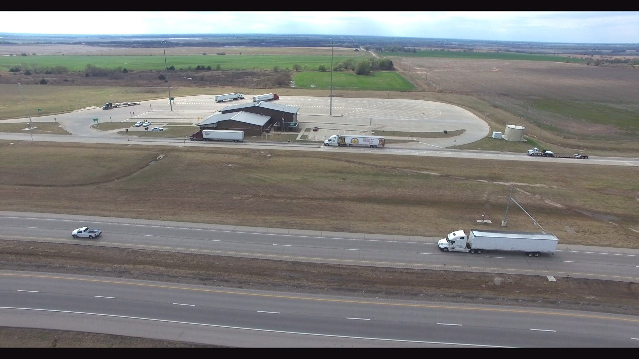
Results of Electronic Screening
6 Million vehicles screened in 2022.
73% Bypass rate in 2022
In-compliance vehicles are able to bypass inspection without stopping.
OCC officers are able to focus on potential delinquent motor carriers.
Trucks do not need any third-party software or transponders to bypass the POE (PrePass, DriveWyze, etc.).

Slide 24
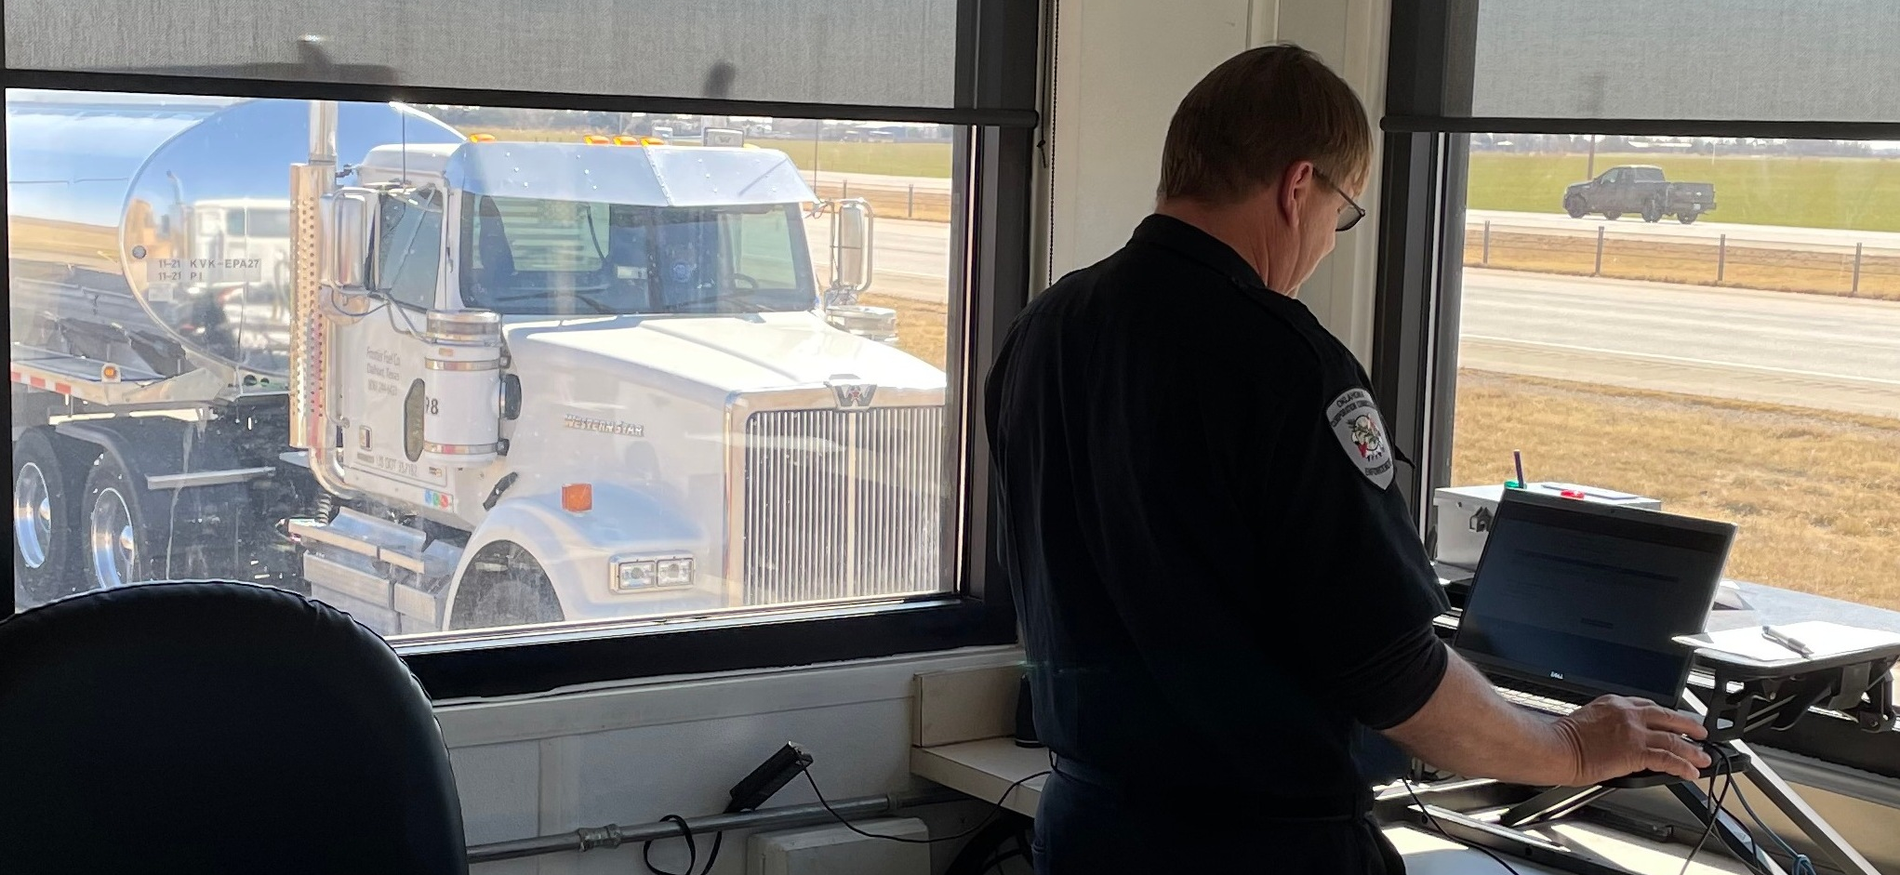
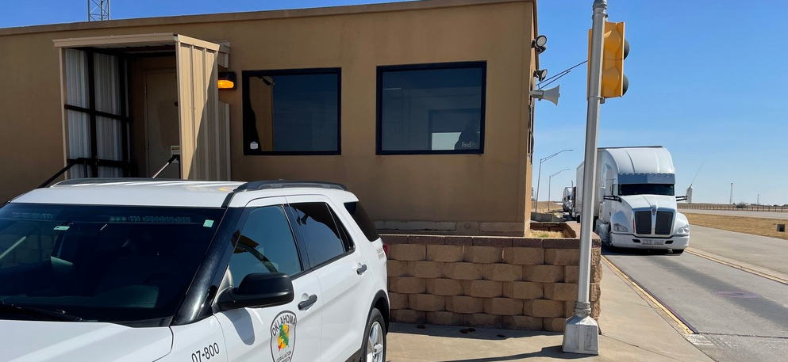
Weigh Stations
OCC operates five scale houses statewide.
Boise City, Davis, and Tonkawa have one scale house each.
El Reno and Hugo have scale houses on both sides of the highway.
All compliance checks at weigh stations are performed manually.
Dedicated staff operate these smaller facilities much like the larger ports of entry.

Slide 25
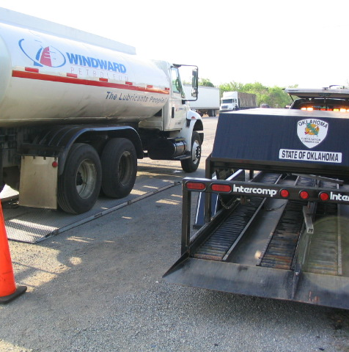
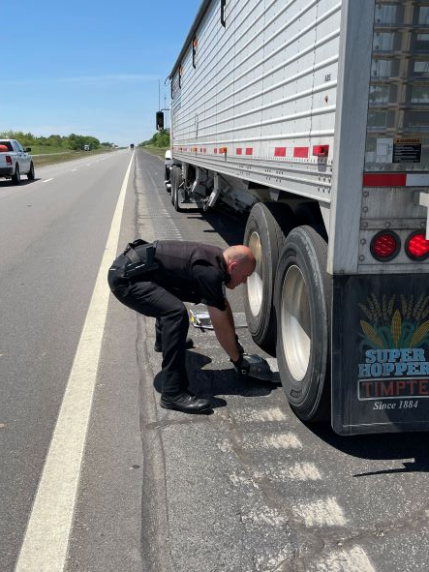
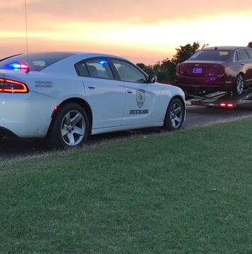
Patrol Radius and Vehicle Compliance
Officers have a patrol radius, set by statute, of 7 miles around Weigh Stations and 25 miles around Ports of Entry.
Vehicles that bypass fixed facilities are stopped by officers if within the patrol area.
Officers utilize vehicle stops to address violators and enforce motor carrier requirements on roadways.
Enforcement is achieved by use of portable scales that are manually placed under vehicles or by use of a semi-portable scale that is off-loaded from a trailer for setup at roadside inspection points.
Officers may require bypassing vehicles to return to fixed facilities for inspection.

Slide 26
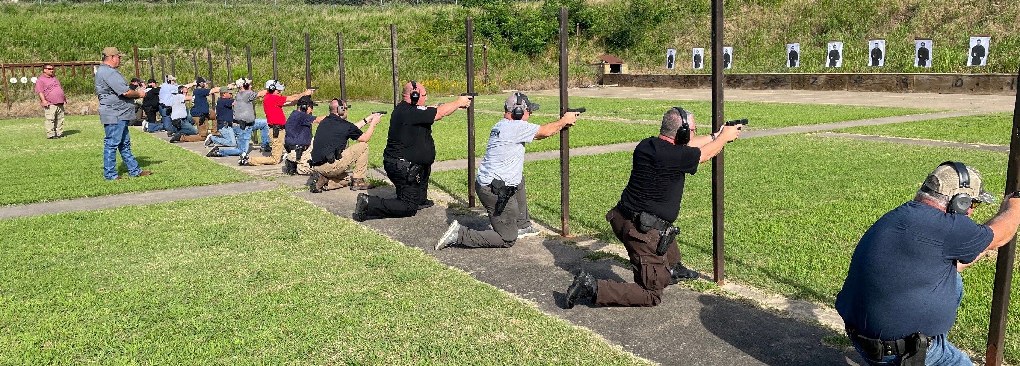
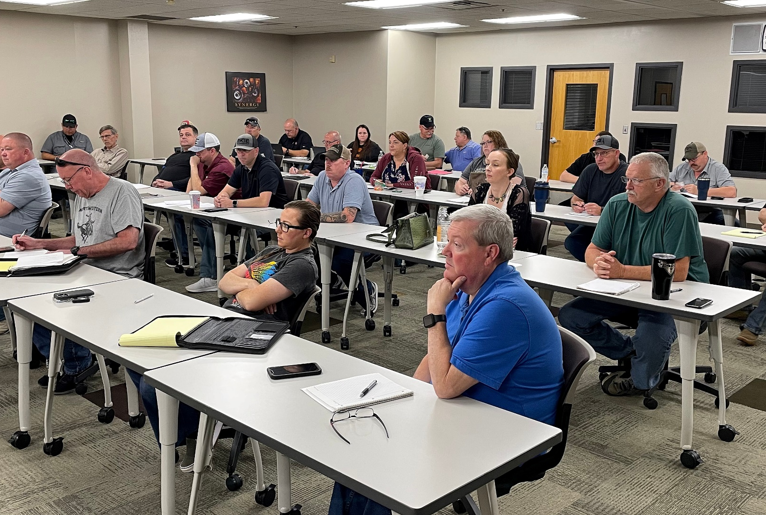
CLEET Certification for Transportation Officers (MCEOs)
OCC provides mandatory CLEET certification classes in-house to meet the yearly training requirements and ensure officers are up to date on complex motor carrier regulations.
MVEOs also attend the classroom trainings to provide standardization of tasks at all facilities.
OCC instructors perform firearms qualification and training including a yearly “top shot” competition.
New hires undergo a thorough training program led by OCC instructors.
The basic training program begins at the Hugo weigh station and is completed at the officer’s assigned duty station.

Slide 27
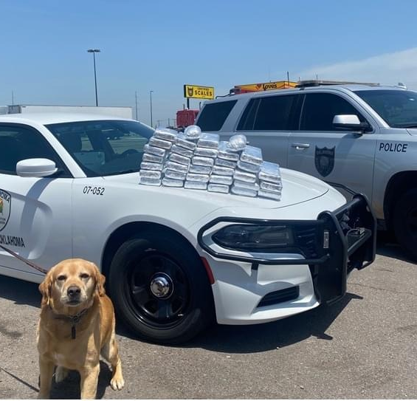
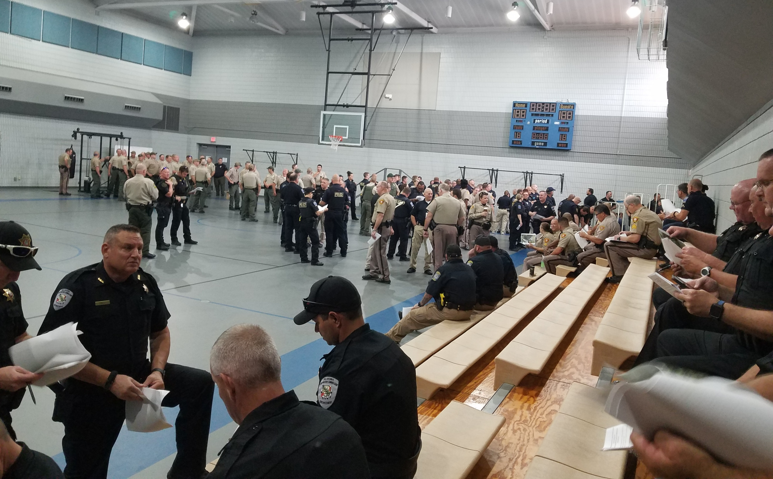
Officers regularly interact with other agencies and are available for assistance within the jurisdictional radiuses of the Ports of Entry and weigh stations.
OCC relays information to other agencies, assists upon request, and has excellent relationships with agencies outside the Commission.

Slide 28
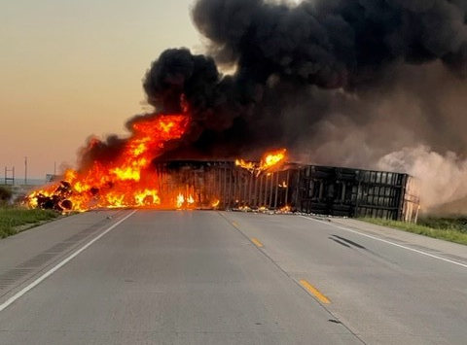
Emergency Response
OCC officers are often first on the scene in various situations and must immediately render aid until additional support arrives.
Officers carry trauma kits in their cars and are trained first responders.
In emergency situations, MCEOs may assist local officers under the general criminal law enforcement authority of Title 21 O.S. § 99a.

Slide 29
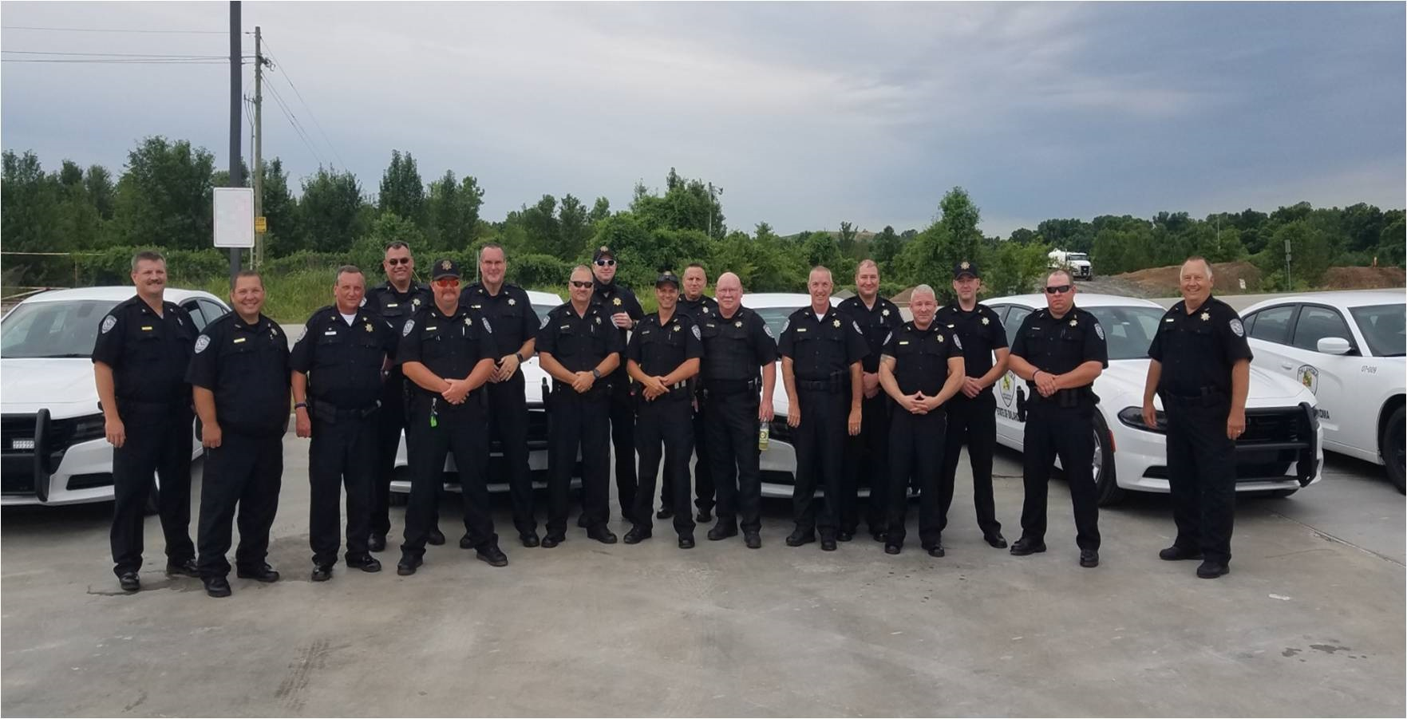
Additional Duties Performed
Weight auditing of motor carriers and shippers for motor carriers that haul overweight as a business practice.
Investigating abuse of all forms of operating authority issued by the Transportation Division.
Assisting the O&G Division by investigating cases of illegal dumping of truck-related deleterious substances.
Assist the railroad Department by inspecting railroad grade-level crossings.

Slide 30
Violations by Category Type
Overweight on Axle, Gross or Bridge
Failure to carry or present vehicle registration or fuel license decal
Failure to register a Commercial Vehicle
No fuel license or decal issued.
Improper markings on power unit.
Failure to yield for inspection
No lease agreement for vehicle
Over 80,000 lbs. on Interstate, without permit
Under registered weight
No active USDOT number
Failure to pay UCR Fee
Operating with No/expired vehicle registration
Altered (forged) documentation
Over length, over height, over width
Violation of special trip permit
Overweight on permit
Federal Out-of-Service (OOS)
No shipping documentation
Refusal to weigh vehicle
Private carrier without a license
Violation of escort permit or improper escort equipment
Failure to secure load
Operating with revoked IFTA
Examples from July 2023 Motor Carrier Docket

Slide 31
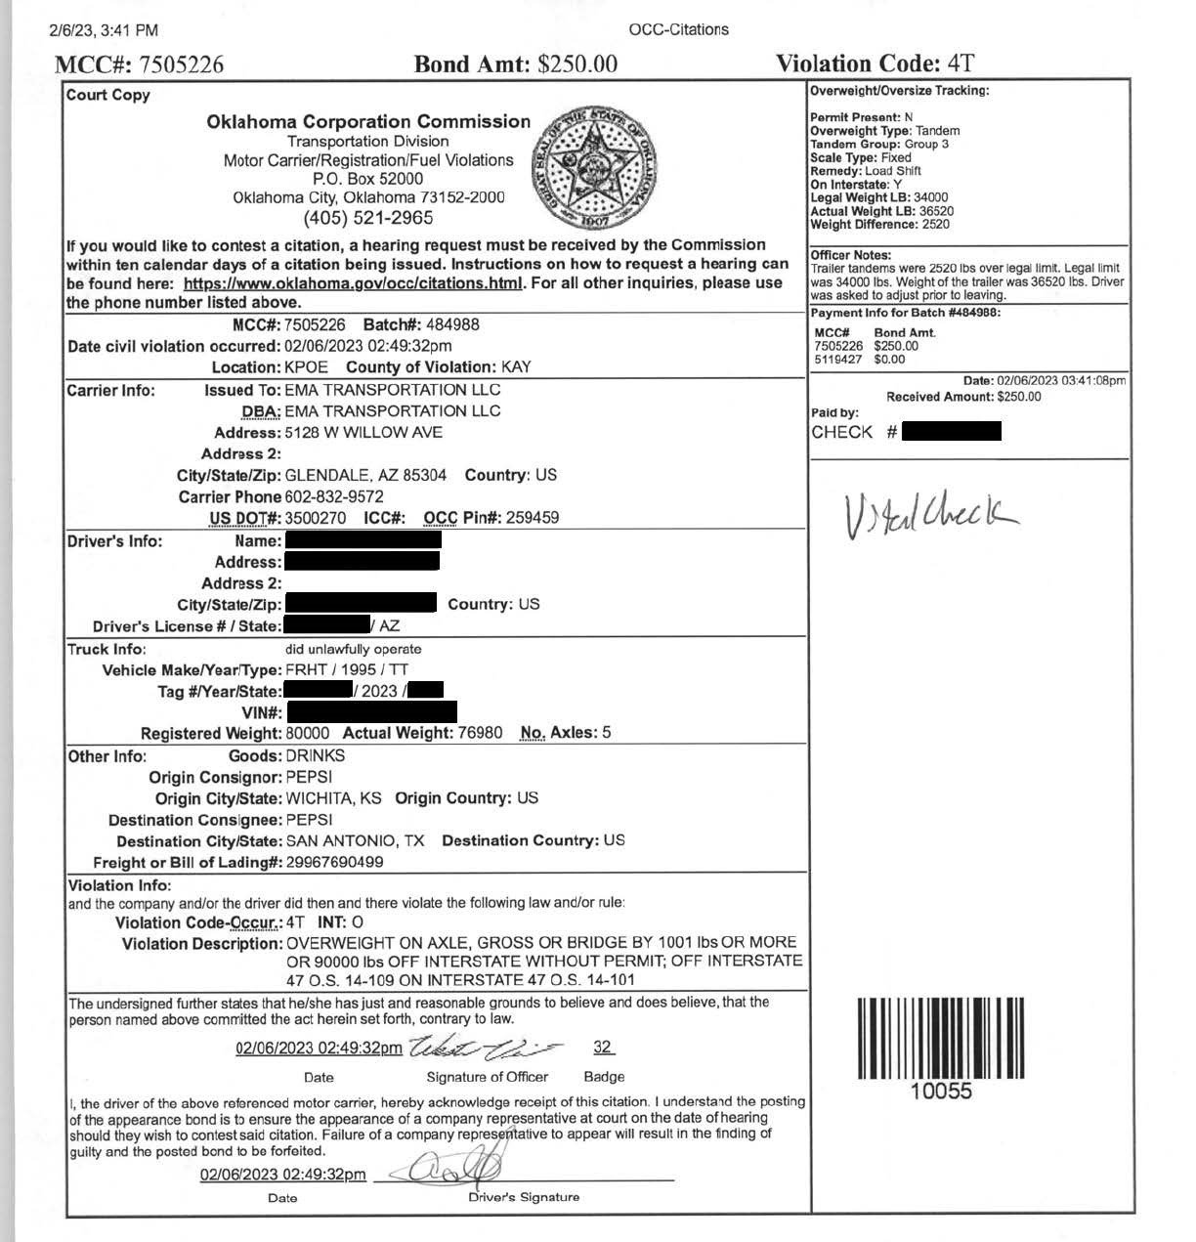
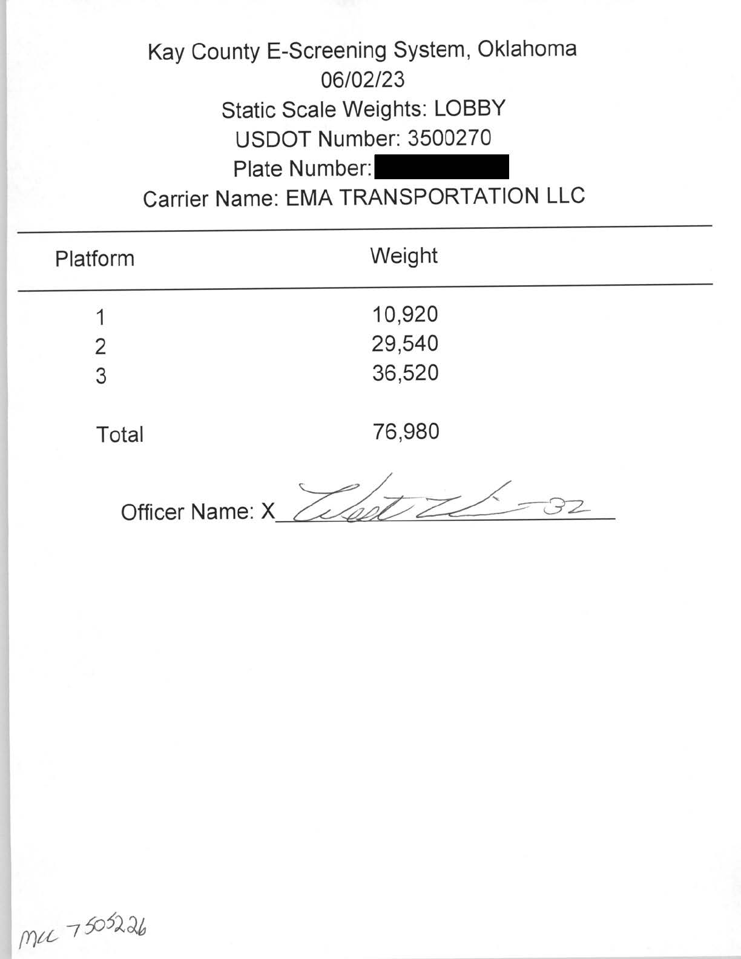
Citation Example
Notes:
Overweight on trailer axles example.

Slide 32
Transportation Enforcement Support & Administration
Enforcement Support assists both field officers and motor carriers at-large
Oklahoma Corporation Commission | Transportation Division

Slide 33
Citation and Payment Processing
Enforcement Support Staff in the main OCC office process citations issued by Transportation officers in the field and track payments received and outstanding.
Payments are processed in Transportation Information Management System (TIMS)
Citations are created and payments are reconciled to the citation in the Oracle Case system
Citations are processed through the Oracle Transportation Database
Citations are then scanned into the OCC electronic document repository

Slide 34
Internal and External Support
Internal Support Functions
Create monthly Motor Carrier Citation Docket summaries and assist Division attorneys in plea negotiations.
Track citation payments received and outstanding.
Prepare requests for court with assistance from general counsel’s office.
Assist officers by obtaining information related to carrier status, outstanding fines owed, and prior violations.
Prepare and update field binders to new officers containing rules, laws, and federal statutes.
Assist with onboarding new field officers.
Provide manual citation and warning books to officers and track inventory.
External Support Functions
Staff the motor carrier support line to assist motor carriers file their citation disputes.
Educate motor carriers on requirements for operation and explain citation violations.
Identify and track outstanding fines and monies owed to DPS.
Report to FMCSA and other agencies regarding out of service carriers and altered documents.
Receive and ensure accuracy of hearing requests for contested citations (averaging 68 requests per docket).
Update VitalChek system logins and passwords.

Slide 35
2023 Citation Volume
All disputed citations are heard by an administrative law judge and are appealable to the Commissioners and the Oklahoma Supreme Court.
No court costs are assessed to the motor carrier.
At the option of the motor carrier, any citation may be disputed by video conference.
Calendar year 2023
January – 5,110
February – 3,663
March – 5,440
April – 4,167
May – 4,619
June – 4,147
July – 3,792

Slide 36
International Fuel Tax Agreement & International Registration Plan
Program Highlights
Oklahoma Corporation Commission | Transportation Division

Slide 37
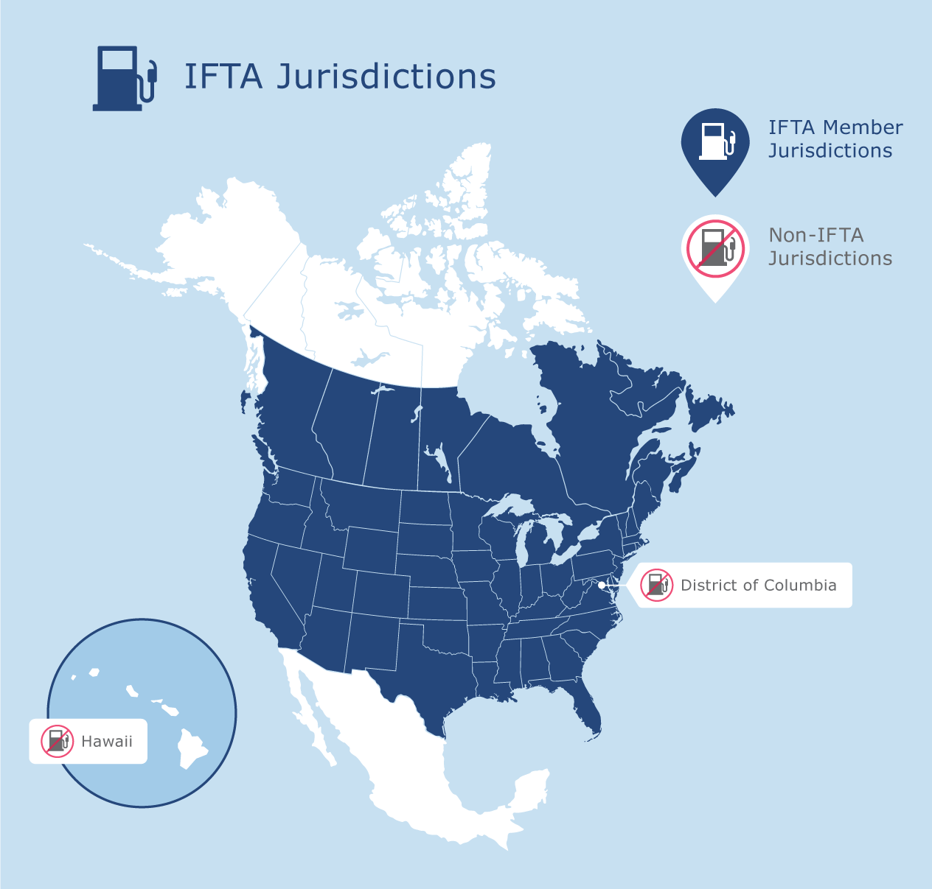
International Fuel Tax Agreement (IFTA) International Registration Plan (IRP), Generally
International/interstate compacts that apportion fuel taxes and registration fees based on motor carrier fuel consumption and miles traveled in each of the member jurisdictions.
The Federal “Intermodal Surface Transportation Efficiency Act” (ISTEA) required that, by 1996, the 48 contiguous states must establish a uniform approach to vehicle registration and motor fuel taxes.*
The compacts establish the “base jurisdiction” concept which allows motor carriers to pick one jurisdiction to report all their fuel tax returns and registration fees to, rather than being required to report to all jurisdictions they travel through.
In 2022, each compact clearinghouse processed, in total:
IFTA: $657 million dollars in fuel taxes.
IRP: $1.3 billion dollars in registration fees.
In 2022, Oklahoma processed (sent/received) through clearinghouses:
$45 million dollars in fuel taxes.
$174 Million dollars in registration fees.
* The Intermodal Surface Transportation Efficiency Act, Title 49 U.S.C. §§ 31701-31707.

Slide 38
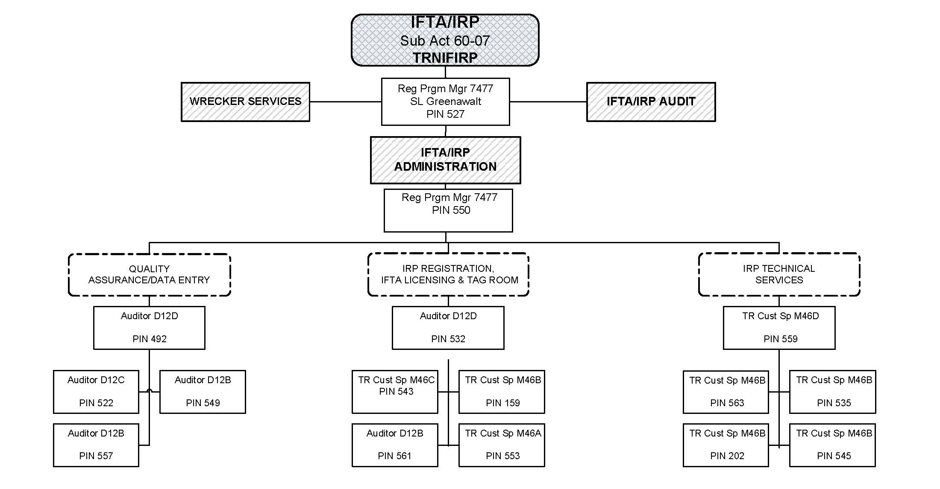
IFTA/IRP Organizational Chart

Slide 39
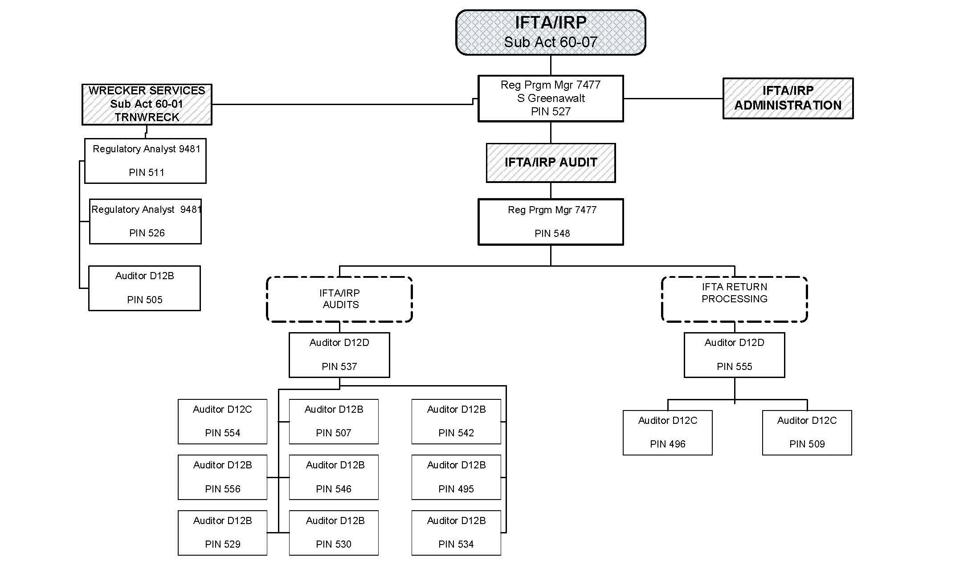
IFTA/IRP Organizational Chart Cont.

Slide 40
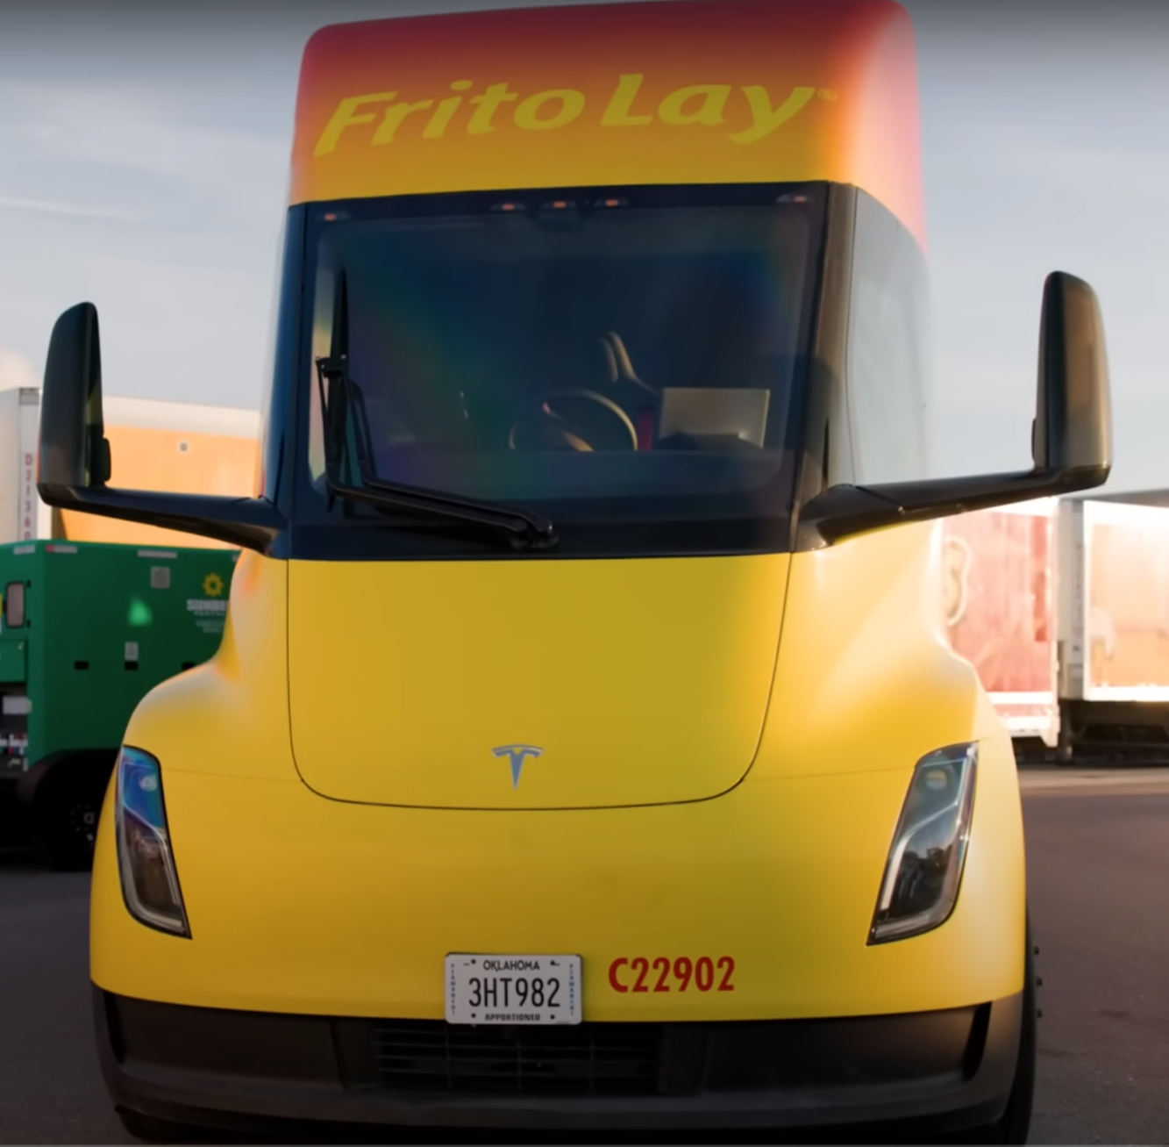
IFTA/IRP at the Corporation Commission
OCC is required to:
Submit timely payments to the other member jurisdictions on a monthly basis.
Audit Oklahoma’s motor carriers in conformity to the compact's requirements (set number of audits, qualitative audits based on fleet types, etc.).
Update tax rates quarterly.
Submit to regular Program Compliance Reviews (audits) of compact administration every five years for each program.
Abide by all compact governing documents and rules.
Track and issue IFTA license/decals and IRP license plates/cab cards for each interstate commercial motor vehicle registered in Oklahoma.
Pay membership dues to both IFTA and IRP.
Submit annual reports.

Slide 41
International Registration Plan (IRP)
Commission obligations in administering the IRP:
Payment to other jurisdictions: CMV registration fees are apportioned based on distance traveled in each jurisdiction, which is applied to each jurisdiction’s fee schedule based on each vehicles’ weight. Those apportioned fees are filed through the IRP clearinghouse, netted (owed vs. received fees) and settled every month. The cycle then starts over for the next month.
Number of audits: OCC is required to audit 3% of Oklahoma registered interstate motor carriers annually, based on renewed fleet registrations.
Qualitative audits: An IRP auditor is required to evaluate a motor carrier’s distance accounting system to determine if the system can be relied upon. Based on the study and evaluation of internal controls, the auditor needs to determine the nature and extent of procedures necessary to test the system or controls, conduct those tests, and decides if the proper registration fees have been paid.
OCC is required to sell 72-hour trip permits which are intended for motor carriers who infrequently perform interstate moves. Trip permits must be purchased in every state the motor carrier passes through. A trip permit is purchased in place of IRP registration.
Oklahoma IRP Fleets registered in FY23: 4,445 Fleets.
Number of Oklahoma IRP Registered Vehicles in FY23: 131,346 power units.
Number of IRP audits required annually: 105 motor carrier audits.

Slide 42
International Fuel Tax Agreement (IFTA)
Commission obligations in administering the IFTA:
Inter-jurisdictional fund transfers are based on fuel consumption, meaning fuel taxes are apportioned to the jurisdiction, at that jurisdiction’s tax rate, where the fuel is used, not where it is purchased. The fuel tax netting process is reconciled monthly through the IFTA clearinghouse.
Because Oklahoma’s fuel tax rates are lower than surrounding states, Oklahoma is typically a net-debtor to the other jurisdictions. The legislature anticipated this and requires the Oklahoma Tax Commission to cover IFTA obligations when collections are less than what is owed to the other jurisdictions. See Title 68 O.S. § 602.
The Commission audits motor carriers to ensure quarterly fuel tax returns are accurate. Audits must:
Cover 3% of all Oklahoma licensees.
Have a minimum of 15% of audits performed for “low mileage” licensees, and 25% of audits must be “high mileage” licensees.
Test and validate trip and fuel purchase records compared to the motor carrier’s quarterly fuel tax returns.
Over 15,000 tax returns processed annually.
Oklahoma has over 3,600 individual IFTA licensees and performs over 100 audits annually.

Slide 43
Transportation Requirements Department
Oklahoma Corporation Commission | Transportation Division

Slide 44
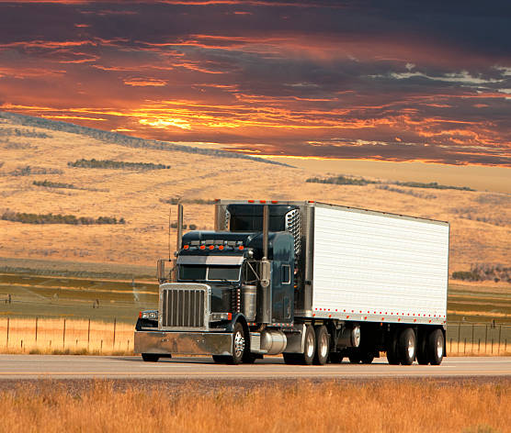
Requirements Department Duties and Functions
Issues intrastate motor carrier licenses (both for-hire and private) and ensures continuous insurance coverage for all licensees.
Other forms of licensure issued by Requirements include:
Household Goods Certificate
Deleterious Substance Transport Permit (DSTP)
Harvest Permits
Hazard Waste permits
Transportation Network Company (TNC) Permits
The Requirements Department has a customer-facing counter to advise new entrants on how to establish their transportation business and how to comply with applicable laws.
Unified Carrier Registration (UCR) – Established by federal law as an annual fee on interstate carriers, based on fleet size, to supplement funding for state highway motor carrier registration and safety programs.

Slide 45
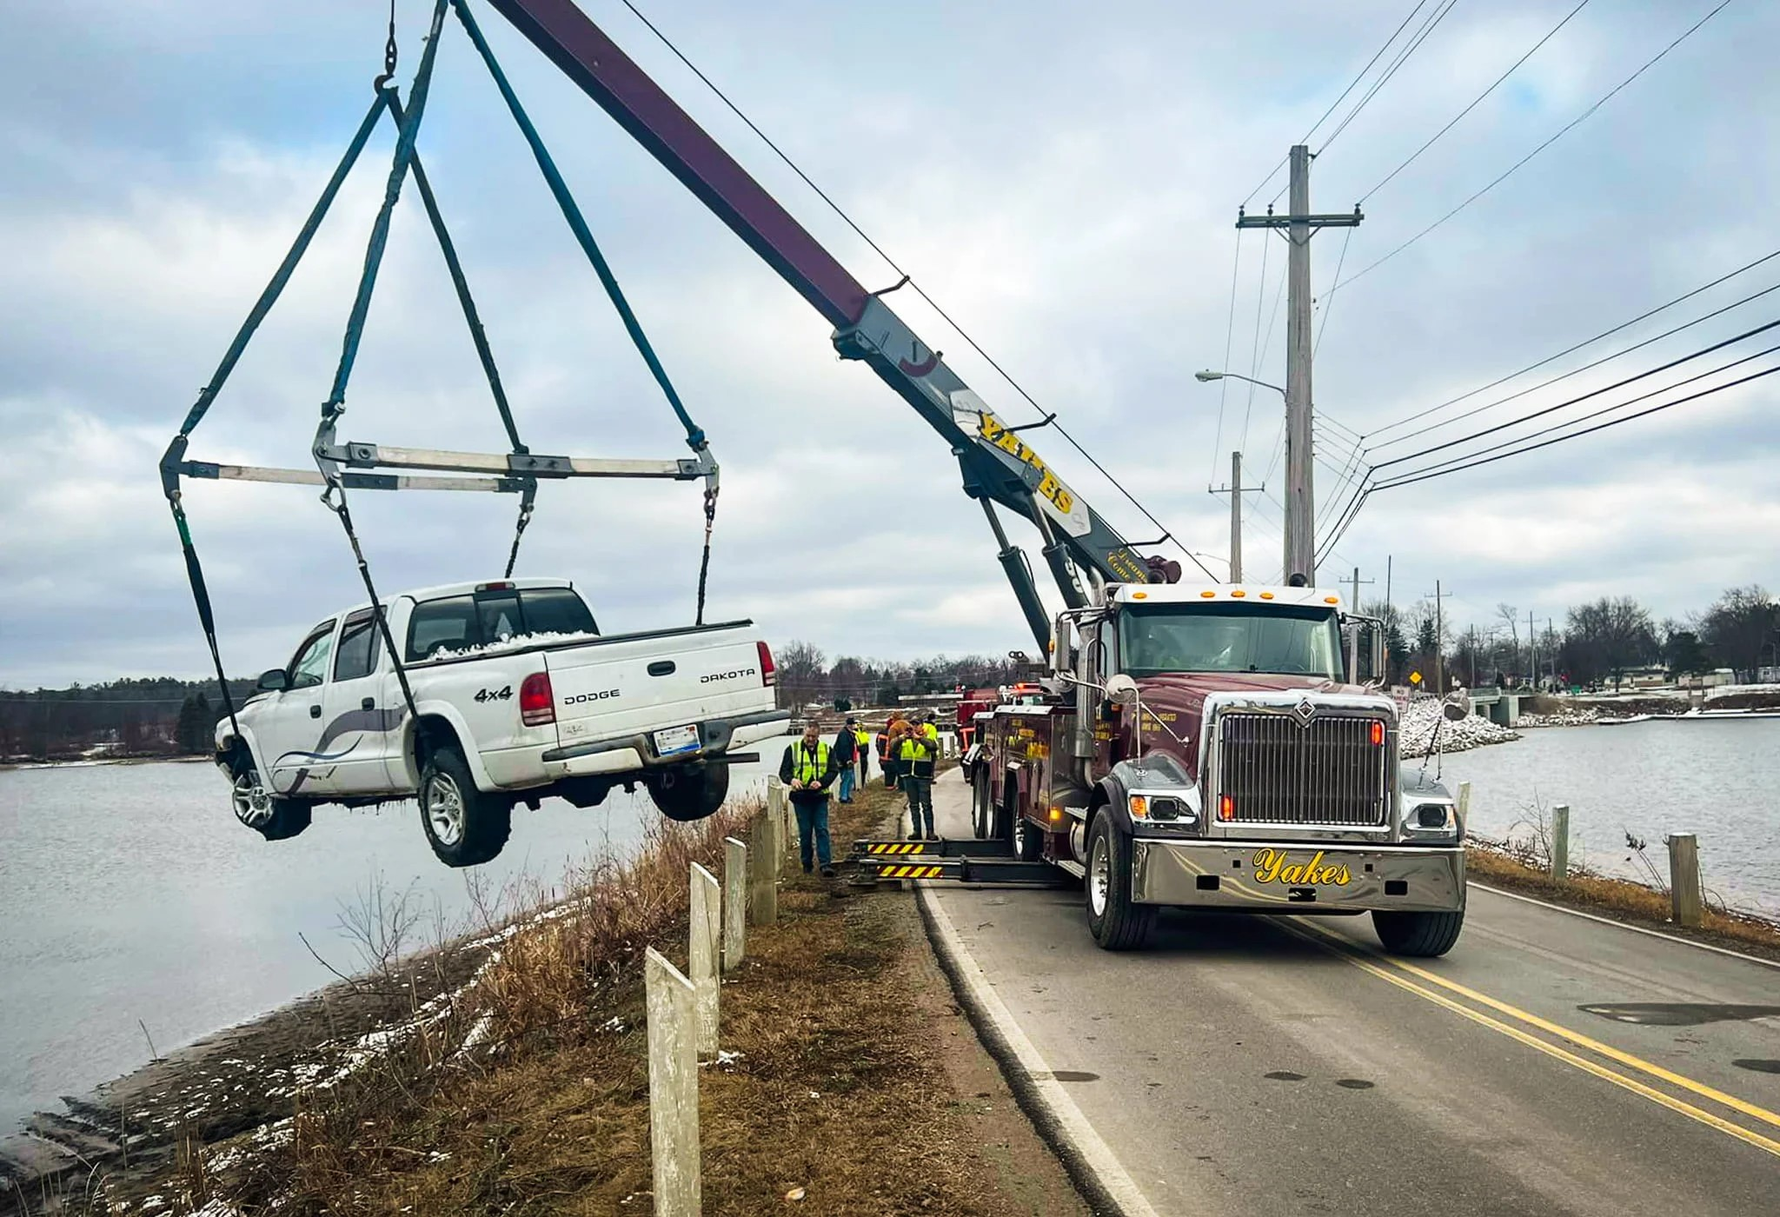
Nonconsensual Towing
Duties and functions of the Nonconsensual Towing department include:
Establish rates through the Commissions ratemaking procedure.
First rates established in 2012.
Administering the Complaints Process regarding overcharges and requires refund to customers when warranted.
Conducting random audits of the rates charged by wrecker services.
Department funded by annual assessment on all licensed wreckers.

Slide 46
Transportation Division Budget
The Trucking One-Stop Shop Fund (TOSS)
Oklahoma Corporation Commission | Transportation Division

Slide 47
TOSS Revenue Sources

Slide 48
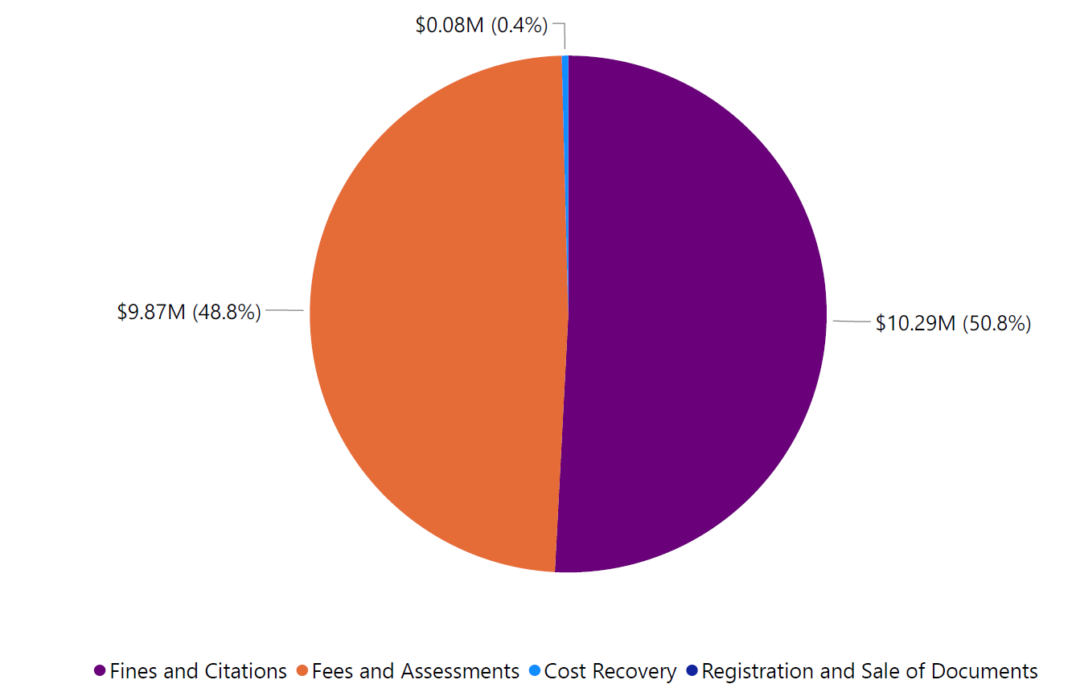
TOSS Revenue to OCC FY2023

Slide 49
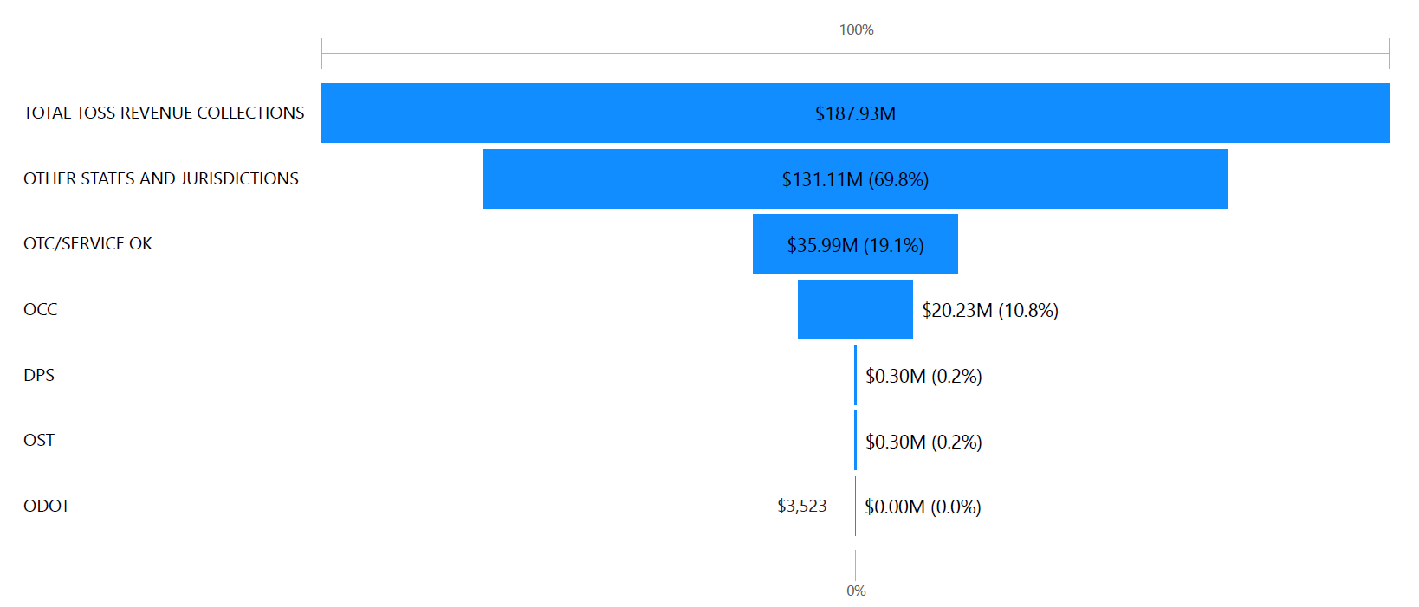
TOSS Revenue Allocation?

Slide 50
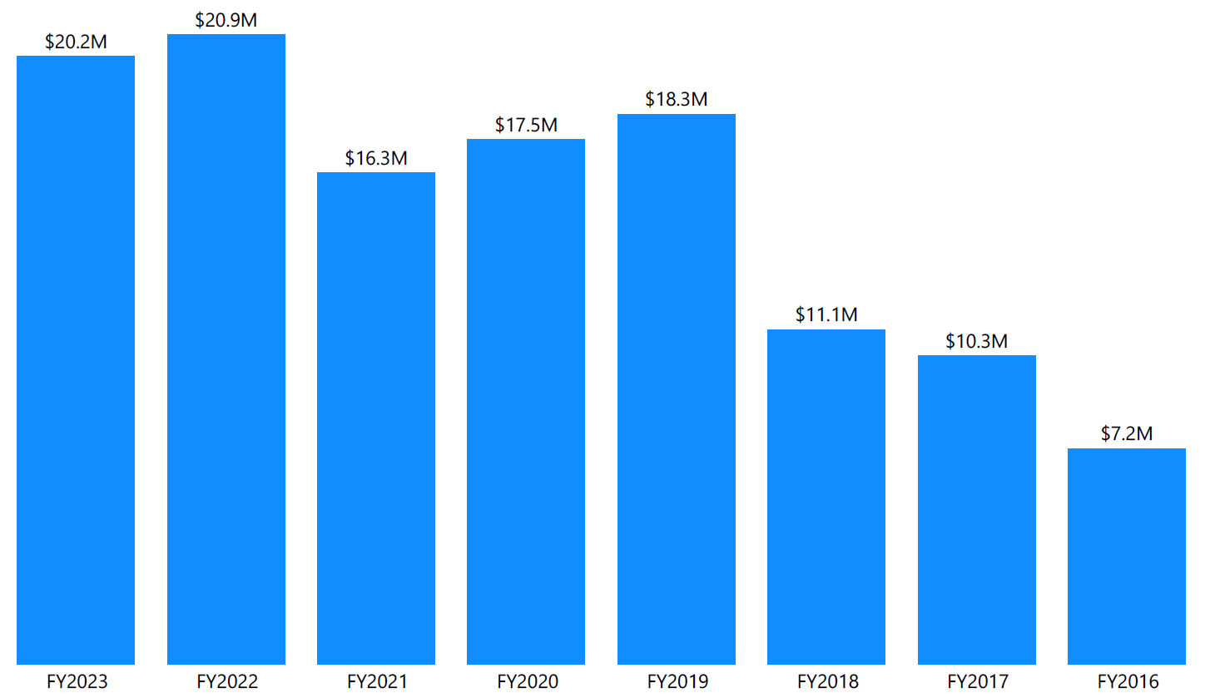
How Much TOSS Revenue does OCC Retain Each Year?
Notes:
Historic view of TOSS revenue.

Slide 51
What Programs are Funded at OCC with TOSS Revenue?
TOSS Revenue
Field Enforcement
61%
Other Direct Personnel Costs for Enforcement and IFTA/IRP Programs
27%
IFTA/IRP
12%
Field enforcement is 81% funded by TOSS and 19% funded by appropriations.
FY23 is the only year the program did not require funding from OCC revolving fund.
These other direct costs include administrative and court functions, subsidized by other OCC Divisions.
TOSS percentage to total court cost is 32% of expenses.
IFTA/IRP is 100% funded by TOSS revenue

Slide 52
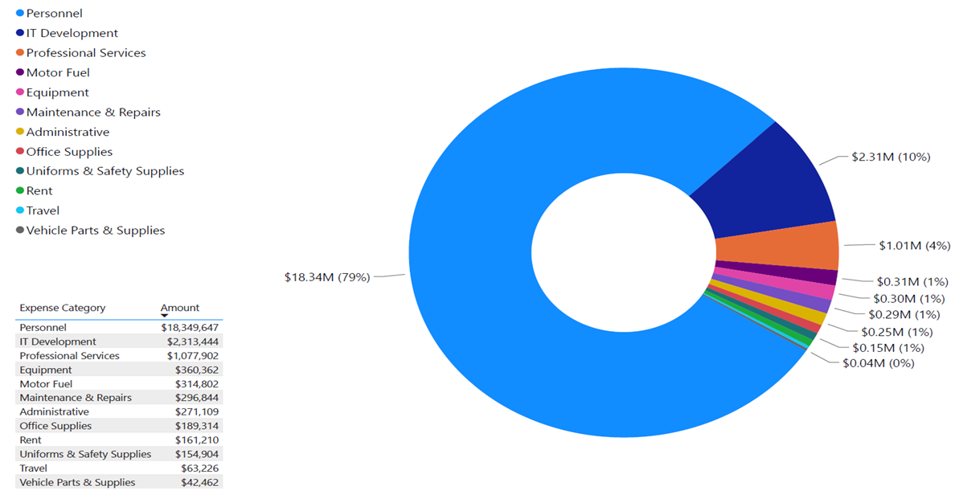
What does OCC Spend TOSS Revenue on?

Slide 53
Transportation Pipeline Safety
Oklahoma Corporation Commission | Transportation Division

Slide 54
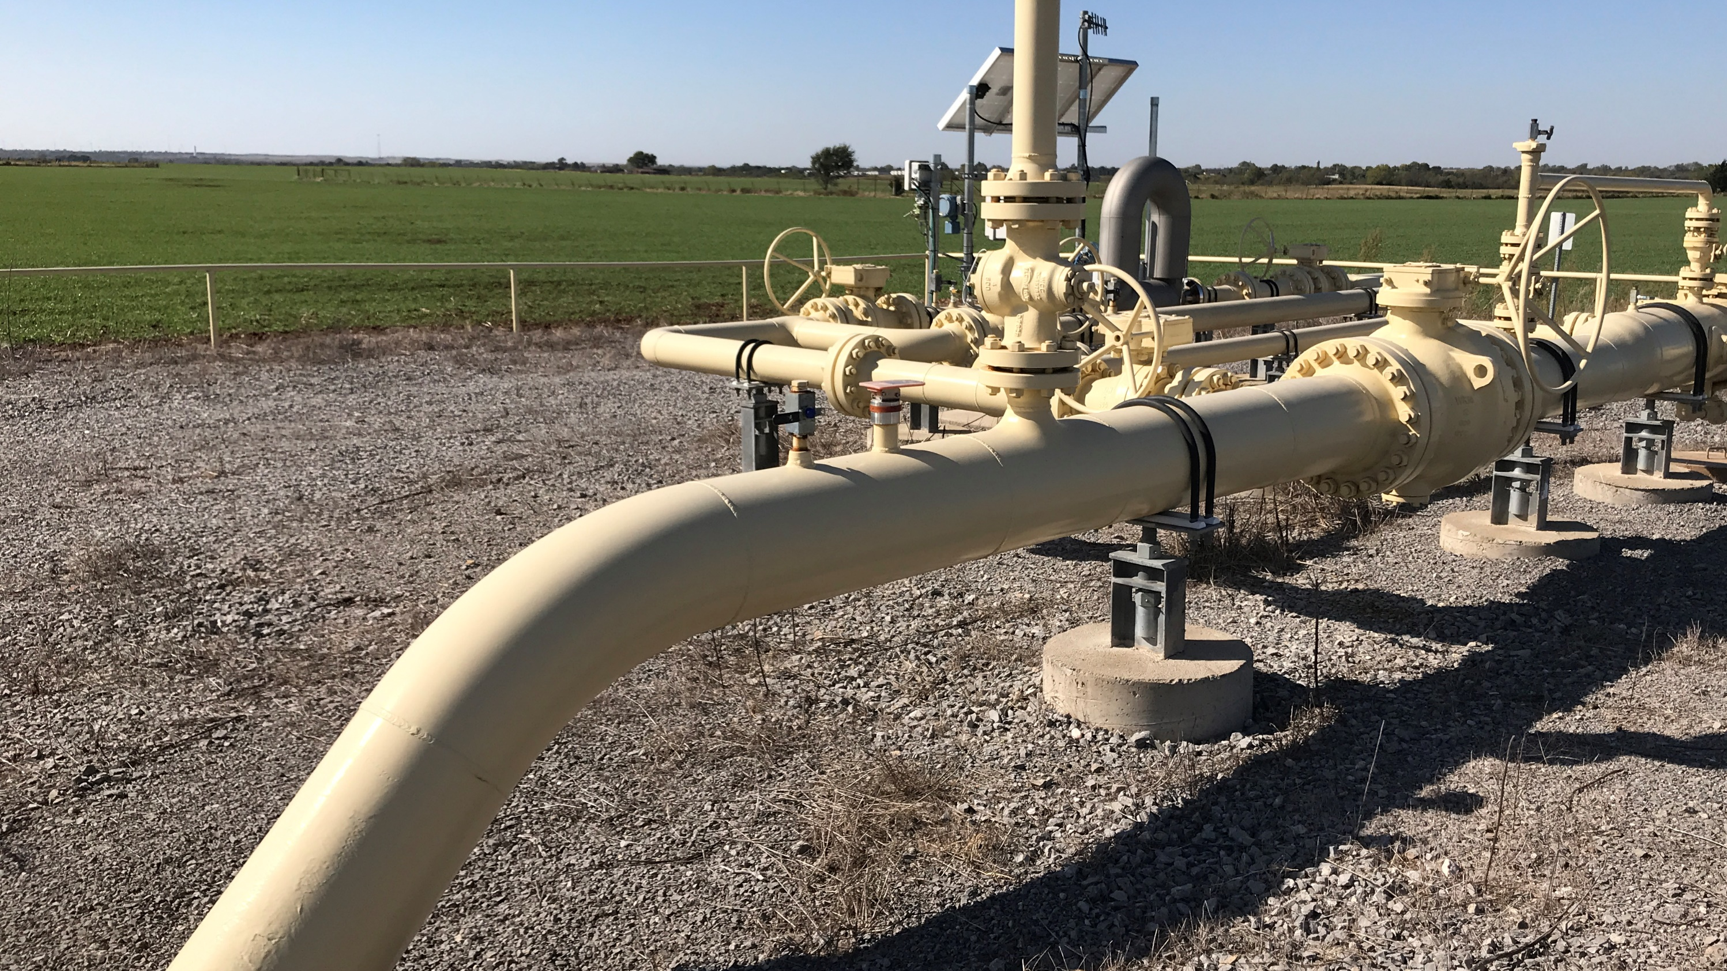
Pipeline Safety
The department enforces federal rules and regulations on pipeline operators, including Gas Gathering, Gas Transmission, Gas Distribution, Hazardous Liquid (Crude, Products, HVLs, CO2) and UNGS
With the federal rule changes of May 2022, the miles of piping regulated by the department went from 48,000 miles to an additional 100,000+ miles.

Slide 55
In addition to standard O&M inspections of procedures & records the department performs six specialized inspections of operators.
The department oversees 290+ operators and enforces excavation damage occurring to regulated oil or gas pipelines in Oklahoma.
There are approximately 1900 excavation damage events a year.
The Department includes:
1 manager
2 Field Supervisors
2 Administrative Officers
16 Field Inspectors

Slide 56
Transportation Railroad Department
Oklahoma Corporation Commission | Transportation Division

Slide 57
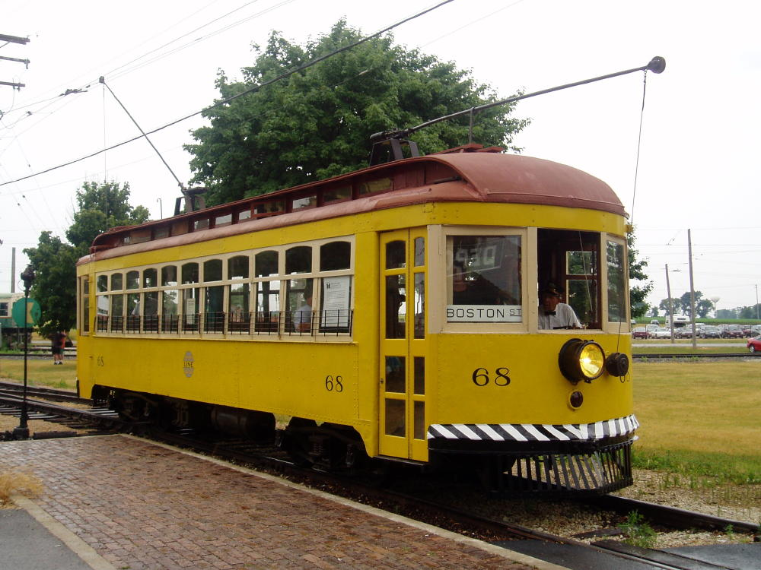
Commission Regulation of Railroads
The commission regulates:
All public, at-grade (street-level) railroad crossings quality.
Public crossings are those that intersect with a road under the jurisdiction of and maintained by a public authority and open to the traveling public.
All approaches (the road on both sides of the crossing) must be under the jurisdiction of the public authority and no approach may be on private property.
Crossing sightlines and trash abatement are also under Commission authority.

Slide 58
Q&A
Mark A. Willingham
Chief Legal Counsel
Mark.Willingham@occ.ok.gov

Slide 60
Apportioned Fuel Tax Example

