Slide 1
Oklahoma Corporation Commission Deep Dive into Transportation Revenue
October 20, 2023

Slide 2
Goals of Today’s Presentation
Define OCC’s current revenue streams that support motor carrier enforcement effort and answer questions from previous task force meetings
Oklahoma Corporation Commission | Finance

Slide 3
Goals of Today’s Presentation
Define OCC’s current revenue streams that support motor carrier enforcement effort and answer questions from previous task force meetings
Discuss critical impact to citation revenue dependent on where and how citations are processed
Oklahoma Corporation Commission | Finance

Slide 4
Goals of Today’s Presentation
Define OCC’s current revenue streams that support motor carrier enforcement effort and answer questions from previous task force meetings
Discuss impact to citation revenue dependent on where and how citations are processed
Identify areas for further task force consideration with potential move of enforcement effort away from OCC
Oklahoma Corporation Commission | Finance

Slide 5
Transportation Division Revenue Sources
Oklahoma Corporation Commission | Finance

Slide 6
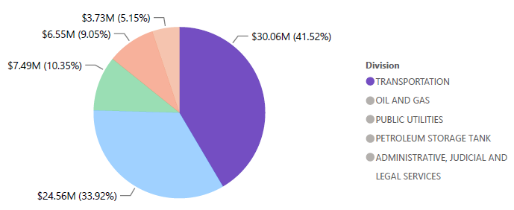
Total OCC Revenue by Divisions- $72,390,004

Slide 7
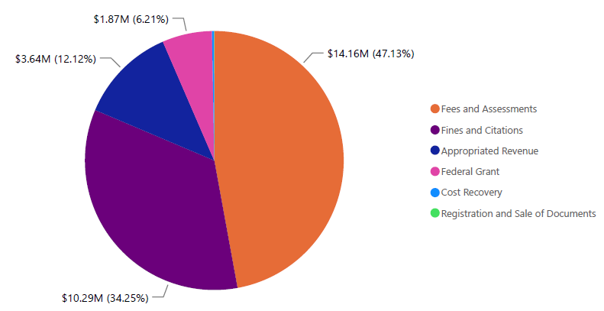
Total Transportation Division Revenue by Category- $30,057,355
These 2 categories are related to motor carrier field enforcement

Slide 8
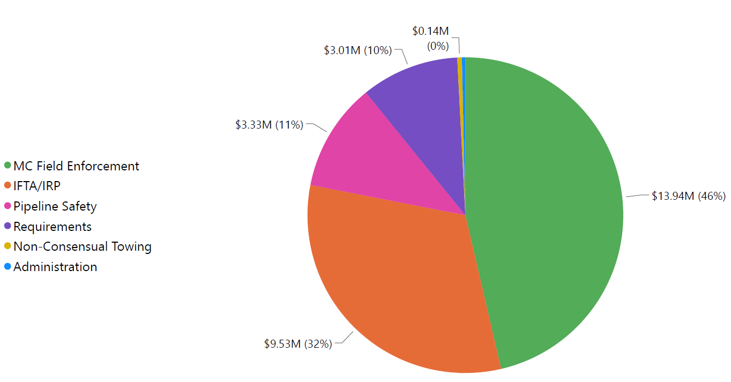
Total Transportation Revenue by Department- $30,057,355

Slide 9
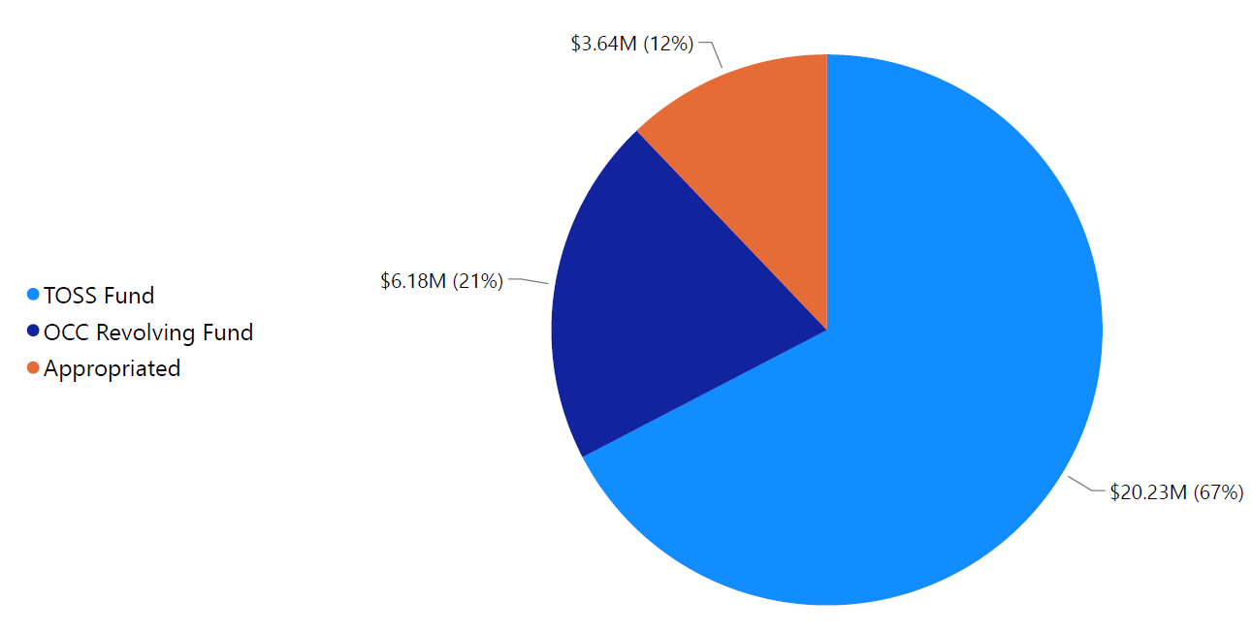
Total Transportation Revenue by Fund- $30,057,355

Slide 10
Trucking One Stop Shop (TOSS) Fund
Oklahoma Corporation Commission | Finance

Slide 11
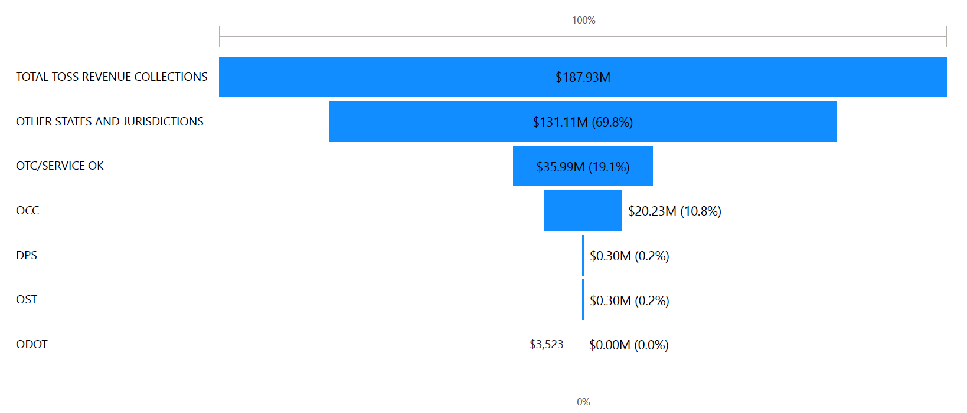
Total OCC TOSS Revenue- $20,232,141

Slide 12
TOSS Revenue Sources
$10,292,369
$9,874,259

Slide 13
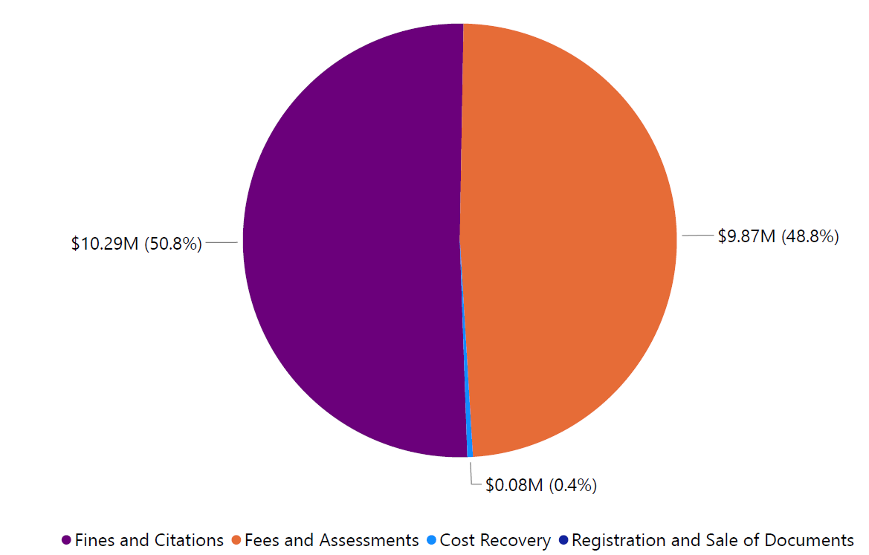
Portion of TOSS Revenue to OCC by Category-$20,232,141

Slide 14
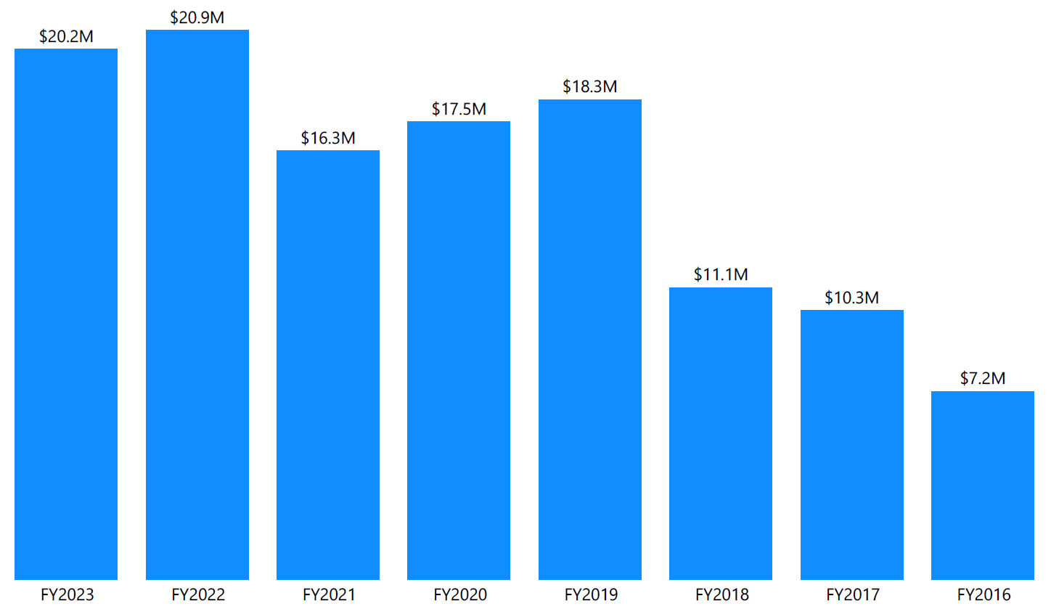
How Much TOSS Revenue does OCC Retain Each Year?

Slide 15
TOSS Fund and OCC Motor Carrier Field Enforcement
Oklahoma Corporation Commission | Finance

Slide 16
Motor Carrier Field Enforcement Program Effort Funding at OCC
Below costs are actual expenditures for each FY represented
Expenses | FY2019 | FY2020 | FY2021 | FY2022 | FY2023
MC Field Enforcement | $12,367,405 | $13,033,826 | $13,030,649 | $12,769,734 | $13,995,465
IT-Related to MCFE | $806,820 | $962,318 | $1,716,967 | $2,495,298 | $3,285,993
Other Direct Personnel | $3,048,873 | $3,767,168 | $4,466,688 | $4,495,079 | $5,239,932
Total MCFE Expenses | $16,223,098 | $17,763,312 | $19,214,304 | $19,760,111 | $22,521,390
Expenses by Fund | FY2019 | FY2020 | FY2021 | FY2022 | FY2023
Appropriations | $2,657,044 | $3,817,150 | $3,641,464 | $3,644,180 | $3,644,180
Citations- TOSS | $9,881,621 | $7,911,504 | $6,809,704 | $10,848,850 | $10,292,369
Other TOSS Revenue | $112,603 | $4,385,327 | $5,780,539 | $2,049,279 | $8,584,841
OCC Revolving Fund* | $3,571,830 | $1,649,331 | $2,982,597 | $3,217,802 | $0
Total Funds Spent | $16,223,098 | $17,763,312 | $19,214,304 | $19,760,111 | $22,521,390
*Total 5-year Amount of Gap Funding Provided by OCC- $11,421,560

Slide 17
Motor Carrier Field Enforcement Only Expenses- as OCC operates today
Expenses | FY2019 | FY2020 | FY2021 | FY2022 | FY2023
MC Field Enforcement | $12,367,405 | $13,033,826 | $13,030,649 | $12,769,734 | $13,995,465
IT-Related to MCFE | $454,508 | $270,717 | $393,503 | $275,204 | $523,287
Total MCEF Only Expenses | $12,821,913 | $13,304,543 | $13,424,152 | $13,044,938 | $14,518,752
Revenue by Fund | FY2019 | FY2020 | FY2021 | FY2022 | FY2023
Appropriations | $2,657,044 | $3,817,150 | $3,641,464 | $3,644,180 | $3,644,180
Citations- TOSS | $9,881,621 | $7,911,504 | $6,809,704 | $10,848,850 | $10,292,369
Total Funds Available | $12,538,665 | $11,728,654 | $10,451,168 | $14,493,030 | $13,936,549
Revenue - Expenses | FY2019 | FY2020 | FY2021 | FY2022 | FY2023
Other Funds Required | ($283,248) | ($1,575,889) | ($2,972,984) | $1,448,092 | ($582,203)

Slide 18
Motor Carrier Field Enforcement Only Expenses- if officers moved to DPS
Impact on Revenue of Enforcement Staff being Moved to DPS
$9,942,056*
Average annual
funding need
*Assumes citations are processed outside of OCC
Expenses | FY2019 | FY2020 | FY2021 | FY2022 | FY2023
MC Field Enforcement | $12,367,405 | $13,033,826 | $13,030,649 | $12,769,734 | $13,995,465
IT-Related to MCFE | $454,508 | $270,717 | $393,503 | $275,204 | $523,287
Total MCEF Only Expenses | $12,821,913 | $13,304,543 | $13,424,152 | $13,044,938 | $14,518,752
Revenue by Fund | FY2019 | FY2020 | FY2021 | FY2022 | FY2023
Appropriations | $2,657,044 | $3,817,150 | $3,641,464 | $3,644,180 | $3,644,180
Citations- TOSS | $9,881,621 | $7,911,504 | $6,809,704 | $10,848,850 | $10,292,369
Total Funds Available | $12,538,665 | $11,728,654 | $10,451,168 | $14,493,030 | $13,936,549
Revenue - Expenses | FY2019 | FY2020 | FY2021 | FY2022 | FY2023
Add’l Funds Required | ($10,164,869) | ($9,487,393) | ($9,782,688) | ($9,400,758) | ($10,874,572)

Slide 19
Motor Carrier Field Enforcement Only Expenses- if officers moved to DPS
Motor Carrier Field Enforcement Move to DPS
$9,942,056*
Average annual
funding need
*Assumes citations are processed outside of OCC
Questions to consider
Where does the money come from to make up an almost $10M annual, recurring need if citation revenue is diverted?
Would the legislature be able to increase appropriations accordingly to address funding need?
MCSAP grant funding cannot be utilized for officers to operate the way OCC does today located at fixed facilities
Does DPS currently have another funding source available to adequately fund these officers?

Slide 20
Motor Carrier Field Enforcement Only Expenses- if officers moved to DPS
Motor Carrier Field Enforcement Move to DPS
$9,942,056*
Average annual
funding need
*Assumes citations are processed outside of OCC
Questions to consider (continued)
Who would enforce IFTA and IRP programs compliance?
OCC is unable to project personnel needed to remain at OCC without this question being answered

Slide 21
Change in Citation Processing and Revenue
Oklahoma Corporation Commission | Finance

Slide 22
Citation Revenue Currently at OCC
Expenses | FY2019 | FY2020 | FY2021 | FY2022 | FY2023
MC Field Enforcement | $12,367,405 | $13,033,826 | $13,030,649 | $12,769,734 | $13,995,465
IT-Related to MCFE | $454,508 | $270,717 | $393,503 | $275,204 | $523,287
Total MCEF Only Expenses | $12,821,913 | $13,304,543 | $13,424,152 | $13,044,938 | $14,518,752
Revenue by Fund | FY2019 | FY2020 | FY2021 | FY2022 | FY2023
Appropriations | $2,657,044 | $3,817,150 | $3,641,464 | $3,644,180 | $3,644,180
Citations- TOSS | $9,881,621 | $7,911,504 | $6,809,704 | $10,848,850 | $10,292,369
Total Funds Available | $12,538,665 | $11,728,654 | $10,451,168 | $14,493,030 | $13,936,549
Currently citation revenue funds
68% of direct motor carrier
enforcement at OCC
Revenue - Expenses | FY2019 | FY2020 | FY2021 | FY2022 | FY2023
Other Funds Required | ($283,248) | ($1,575,889) | ($2,972,984) | $1,448,092 | ($582,203)

Slide 23
OCC Administrative Court vs. DPS*
Does DPS currently have statutory authority to hear these citations?
If so, does DPS have adequate staffing for shift in workload?
If not, a cost analysis would need to be performed to understand full fiscal impact of transition
OCC does not believe that legally we could perform hearings for a separate agency’s enforcement effort, so another alternative would have to be identified (Article 9, Section 19 Oklahoma Constitution)
Constitutional administrative court appealed to Supreme Court
All revenue is retained for citations currently - less statutory apportionment of $850K to OTC and DPS
Non-criminal offenses- companies are cited, not drivers
Companies receive a chance to protest within 30 days
OCC divisions share court resources so entire burden isn’t just on Transportation
Officers issue 3,000-5,000 citations per month
OCC
DPS?
*All data is speculative because a formal proposal has not been made

Slide 24
OCC Administrative Court vs. District Court*
Drivers would be cited vs. companies which could negatively impact hiring pool for trucking companies
Applicable court fees would be attached to citation- increasing cost of violation
DPS would not receive 100% of citation revenue, if any
Additional burden placed on District Courts that are already working at maximum capacity
Potential delay in hearing dates due to extensive dockets
Constitutional administrative court appealed to Supreme Court
All revenue is retained for citations currently - less statutory apportionment of $850K to OTC and DPS
Non-criminal offenses- companies are cited, not drivers
Companies receive chance to protest within 30 days
Shared resources with other OCC divisions so entire burden isn’t just on Transportation
Officers issue 3,000-5,000 citations per month
OCC
District Court?
*All data is speculative because a formal proposal has not been made

Slide 25
Currently How OCC Processes Citations Today
Citation is written by officer
Finance processes payment as a bond until court occurs
Enforcement Support prepares the monthly docket and responds to carrier inquiries
Attorneys communicate with carriers who have requested a hearing
Administrative Law Judge hears the docket monthly and makes recommendations
If carrier disagrees with recommendation, they have an opportunity to appeal to the Commissioners
Commissioners hear any appeals and vote on docket monthly
Final order is issued, and all payments are recognized as fine revenue
Enforcement Support generates refund process for dismissed or reduced violations
Finance issues refund check to carrier once approvals are complete

Slide 26
Motor Carrier Field Enforcement Move to DPS
Approximately 50,000 citations are processed annually by OCC
*Number above does not include Bryan Co. POE that opened in October 2023
Questions to consider
By moving the enforcement effort to DPS, where and how would the citations be processed?
How much of an impact on revenue would occur with that move?
If the citation revenue is not enough to sufficiently fund the officers where would the money come from?
Who would enforce IFTA and IRP compliance/audits if the programs are administered at DPS?
Would a new court have the technical expertise to hear the citations?

Slide 27
Closing Remarks and Considerations
Oklahoma Corporation Commission | Finance

Slide 28
Commission Audits Since 2007
Performance Audits
Financial Audits
Grant Audits/Reviews
14 Operational Audits
Dedicated State Auditor & Inspector presence since 2013
17 Independent auditing firms or review boards
IFTA and IRP programs peer reviews every 5 years for compliance, Federal Highway Administration audits every 3 years

Slide 29
How to Move Forward
Items for consideration
What happens to DPS citation revenue today? And if OCC enforcement effort is moved to DPS?
Potential other solutions
Increase outdated fine schedule and reallocate increased portion of revenue to DPS and ODOT
Operate under a partnership agreement like other 36 states
Additional resources needed
Can the District Courts take on burden of processing the high volume of citations?
Could DPS process citations differently than they do today to handle administrative court duties?
Where does the additional revenue come from to support the enforcement officers?
If so, at what cost? Highly recommend in-depth fiscal analysis be performed before transfer is recommended
Who would enforce IFTA and IRP programs for compliance?
McGirt is not an issue for OCC since we are a regulatory agency, for others it might be

Slide 30
Holly George | Chief Financial Officer
p. 405-522-2045 | c. 405-517-0456
Oklahoma.gov | https://oklahoma.gov/occ.html

Slide 31
Appendix- OCC Revenue Detail for Transportation 5-year History
Oklahoma Corporation Commission | Finance

Slide 32
Appendix- Detail of All OCC Transportation Revenue Retained All numbers reflect OCC’s portion of actual revenue retained
OCC Revenue | FY2019 | FY2020 | FY2021 | FY2022 | FY2023
Citations- TOSS | $9,881,621 | $7,911,504 | $6,809,704 | $10,848,850 | $10,292,369
Appropriations | $2,657,044 | $3,817,150 | $3,641,464 | $3,644,180 | $3,644,180
IRP- ARCS Fee | $3,819,566 | $6,300,480 | $6,446,774 | $6,739,332 | $6,831,804
IRP- Registration | $2,697,045 | $1,627,446 | $1,492,895 | $1,543,487 | $1,443,012
IRP- Fuel Permit Service Fee | $508,250 | $617,870 | $725,040 | $870,020 | $732,900
IRP- MLA Fee | $12,232 | $6,157 | $2,513 | $3,663 | $2,129
IRP- 72 HR Permit (in lieu of IRP registration) | $102,112 | $31,515 | $36,406 | $43,128 | $37,783
IFTA- License & Decals | $378,442 | $355,046 | $317,346 | $323,860 | $332,894
IFTA- Reinstatement Fee | $75,932 | $62,800 | $36,100 | $72,900 | $78,900
IFTA- 120 HR Permit (in lieu of IFTA license) | $65,842 | $59,284 | $70,768 | $86,156 | $69,260

Slide 33
Appendix- Detail of All OCC Transportation Revenue Retained All numbers reflect OCC’s portion of actual revenue retained
OCC Revenue | FY2019 | FY2020 | FY2021 | FY2022 | FY2023
TRN Network Co Permit | $15,000 | $15,000 | $10,000 | $15,000 | $20,000
Unified Carrier Registration | $2,457,796 | $2,457,796 | $2,457,796 | $2,457,796 | $2,457,796
Household Goods-Sub-application | $10,250* | $15,450* | $2,150 | $600 | $300
Household Goods- Original application |  |  | $5,250 | $7,000 | $4,900
Household Goods- Renewal |  |  | $13,800 | $13,800 | $13,800
Identification Device Fee | $136,081 | $115,173 | $113,008 | $114,212 | $117,516
Intrastate-MC License-Application | $104,460 | $89,410 | $91,600 | $106,600 | $98,200
Intrastate-MC License-Renewal | $118,564 | $113,000 | $75,000 | $69,700 | $68,250
Intrastate-MC License- Reinstatement | $0 | $0 | $200 | $100 | $0

Slide 34
Appendix- Detail of All OCC Transportation Revenue Retained All numbers reflect OCC’s portion of actual revenue retained
OCC Revenue | FY2019 | FY2020 | FY2021 | FY2022 | FY2023
Intrastate-PC License-Application | $28,518* | $20,800* | $17,300 | $22,600 | $39,150
Intrastate-PC License- Renewal |  |  | $39,500 | $42,300 | $18,100
Intrastate-MC/PC License-Upgrade/downgrade | $0 | $0 | $250 | $750 | $750
Name Change-Application Fee | $2,500 | $2,000 | $1,900 | $2,350 | $4,800
Non-Consensual Towing-Assessment | $139,533* | $147,144* | $135,696 | $143,369 | $140,313
Non-Consensual Towing-Late Penalty |  |  | $4,766 | $671 | $1,035
Non-Consensual Towing-Non-Compliance |  |  | $0 | $0 | $616

Slide 35
Appendix- Detail of All OCC Transportation Revenue Retained All numbers reflect OCC’s portion of actual revenue retained
OCC Revenue | FY2019 | FY2020 | FY2021 | FY2022 | FY2023
Harvest Permit- 30 Day | $3,543 | $4,108 | $760 | $1,280 | $2,140
Harvest Permit- 60 Day |  |  | $2,508 | $1,135 | $1,471
Deleterious Substance License | $137,550 | $121,450 | $105,000 | $107,800 | $100,800
Hazardous Waste Fee | $63,950 | $58,150 | $56,775 | $48,100 | $62,850
Filing Fee- TRN Docket | $13,000 | $12,500 | $8,500 | $14,500 | $16,000
Fines/Penalties | $48,181 | $24,640 | $0 | $0 | $500
Grant-PLS-Hazardous Liquid | $1,866,810* | $1,738,107* | $355,278 | $371,273 | $418,551
Grant-PLS-Natural Gas |  |  | $1,288,731 | $1,373,711 | $1,388,850
Grant-PLS-Underground Storage Tank |  |  | $47,703 | $96,689 | $58,458
Cost Recovery- Transportation | $8,322 | $52,656 | $76,225 | $41,009 | $81,607

Slide 36
Appendix- Detail of All OCC Transportation Revenue Retained All numbers reflect OCC’s portion of actual revenue retained
OCC Revenue | FY2019 | FY2020 | FY2021 | FY2022 | FY2023
PLS-Hazardous Liquid Assessment | $1,406,432* | $1,458,625* | $410,810 | $402,079 | $370,077
PLS- Natural Gas Assessment |  |  | $1,061,099 | $1,070,828 | $1,098,610
Copies | $0 | $0 | $0 | $153 | $874
Copies-IMVR Database | $0 | $0 | $7,700 | $8,400 | $0
Rule Books | $5,250 | $6,810 | $7,076 | $9,050 | $5,530
Returned Payment Fee | $0 | $0 | $100 | $280 | $280
Totals | $26,763,825 | $26,873,144 | $25,975,741 | $31,219,012 | $30,057,355
*FY19 and FY20 amounts were combined for certain revenue streams due to the limitations of OCC’s Case Processing system only allowing for 99 revenue codes. With IMS implementation on 07/01/2020, the issue was resolved to allow for more detailed reporting.

